Slide 1
Cosmic Ray Diffusion in Mirror Fluctuations
Sergey Komarov (MPA), Eugene Churazov (MPA), Matthew Kunz (Princeton), Alex Schekochihin (Oxford)
Plasma Kinetics Workshop 2016

Slide 2
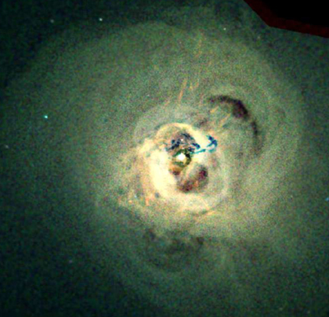
Intracluster medium
turbulent, Re~10
magnetized, Rm~10³⁰
weakly collisional
Chandra X-ray image of the Perseus cluster
Plasma Kinetics Workshop 2016

Slide 3
Cosmic rays in galaxy clusters
1. synchrotron emission from non-thermal electrons
diffuse radio halos
ICM turbulence, product of hadronic colllisions?
radio relics
DSA
2. γ-ray emission
p+p -> π⁰ -> γγ
Fermi-Lat above 10 GeV:
p-pressure < 1.5% of thermal pressure for q=2.1
Prokhorov&Churazov 2014, Ackermann 2014
Plasma Kinetics Workshop 2016

Slide 4
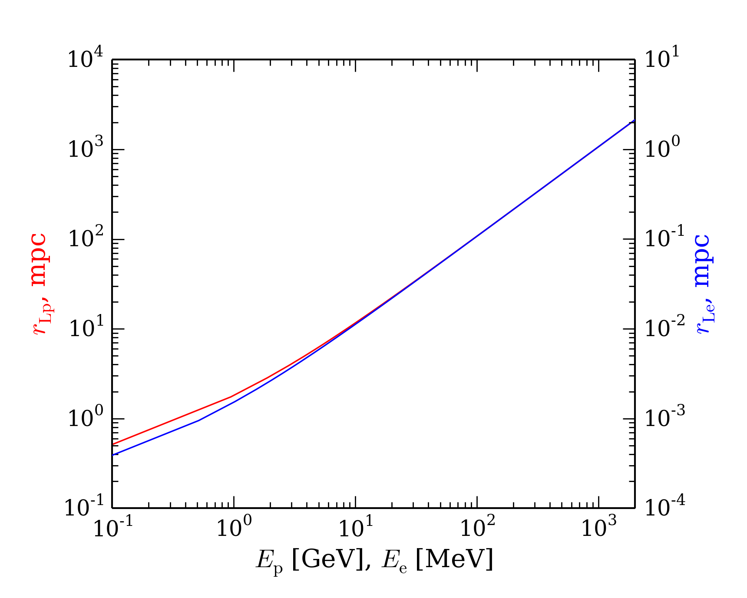


Energies and Larmor radii of CR in ICM
CR diffusion may be suppressed effectively by magnetic fluctuations close to Larmor scales
Plasma Kinetics Workshop 2016

Slide 5
Energies and Larmor radii of CR in ICM
CR diffusion may be suppressed effectively by magnetic fluctuations close to Larmor scales
mirrors
mirror instability in ICM: l_{B}~1 μpc (B=1 μG, T=8 KeV)
mirrors
energy-dependent diffusion coefficient,
expect large suppression near r_{L}
Plasma Kinetics Workshop 2016

Slide 6
Magnetic field structure
folds
turbulent
motions
mirrors
Alfvén-wave cascade
Rincon et al. 2016
Plasma Kinetics Workshop 2016

Slide 7
Simulations of mirror instability (M. Kunz)
Y
PEGASUS hybrid code: kinetic ions, fluid isothermal electrons
Kunz, Stone & Bai 2014
X
shearing periodic box
shearing sheet
Plasma Kinetics Workshop 2016

Slide 8
Properties of the mirror field
1D magnetic fluctuation spectrum of mirror instability
parallel CR diffusion mainly governed by transverse magnetic fluctuations along field line with mean field B₀
in mirrors δB∥/B₀~1, δB⊥/B₀~0.1
l_{B∥}~100 r_{Li}
spatial structure of the mirror instability
Kunz et al. 2014
Plasma Kinetics Workshop 2016

Slide 9
Parallel Diffusivity at High Energies
Jokipii 1969
valid for r_{L}>>l_{B}
calculate small change of pitch angle over l_{B} ->
random walk
exact form depends on field structure, need simulations
Plasma Kinetics Workshop 2016

Slide 10
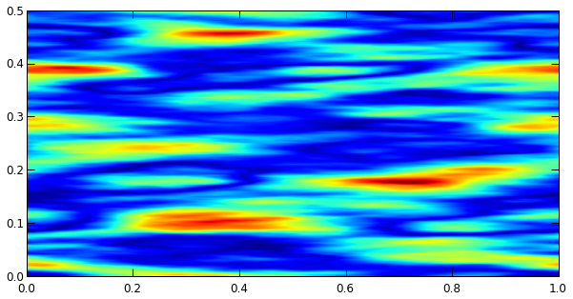
Monte Carlo simulations of CR diffusion
A model to mimick the mirror field
need long 3D box L>>l_{B},r_{L} in z-direction
B₀ along z, B∥/B₀=1, B⊥/B₀=0.1
l_{B∥}/l_{B⊥}=10 (measure of difference from slab)
spectral shape similar to Matt’s simulation (but results are not sensitive to spectrum at r_{L}>~l_{B})
x [l_{B}]
z [l_{B}]
Plasma Kinetics Workshop 2016

Slide 11
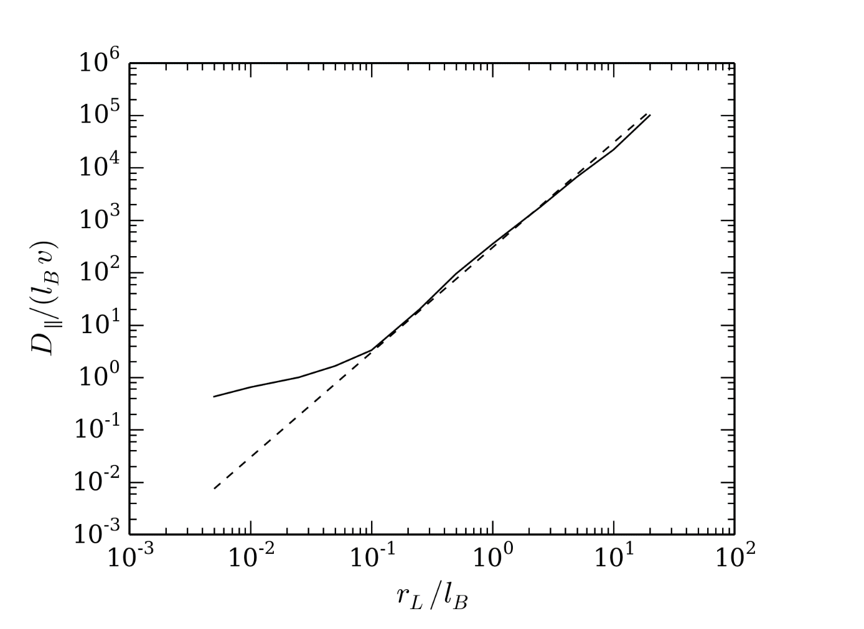
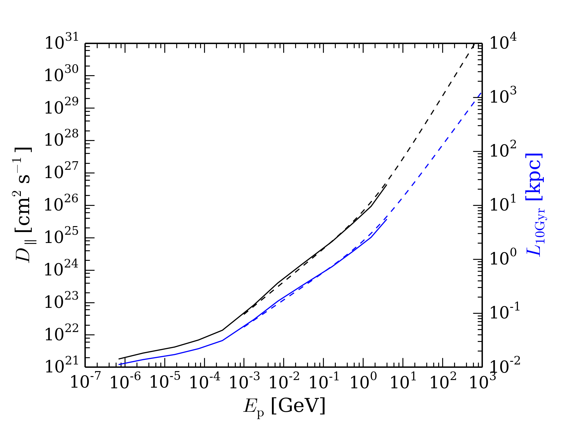
Monte Carlo simulations of CR diffusion
dashed lines:
Plasma Kinetics Workshop 2016

Slide 12
Summary
Mirrors are capable of considerable energy-dependent suppression of CR
CR with energies up to 100 GeV may not escape the ICM
Plasma Kinetics Workshop 2016

