Slide 1
08. Microscopic View of Electrons in Solids in One Dimension: Tight Binding Chain
Interlude & Preview

Slide 3
https://en.wikipedia.org/wiki/Variational_method_(quantum_mechanics)
“ ”

Slide 14
“ ”

Slide 16
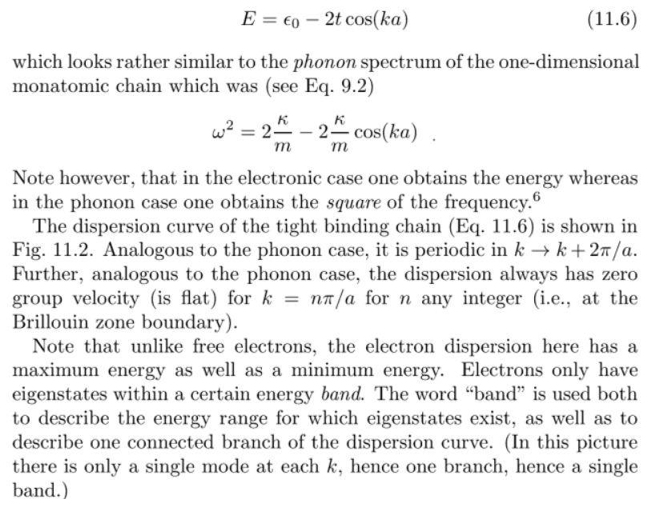
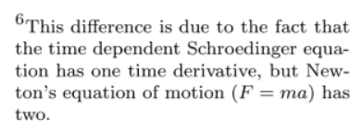
https://en.wikipedia.org/wiki/Schr%C3%B6dinger_equation

Slide 21
From Lecture 04
~0.01c

Slide 22
From Lecture 04

Slide 32
(POINT)
Sommerfeld’s theory

Slide 41
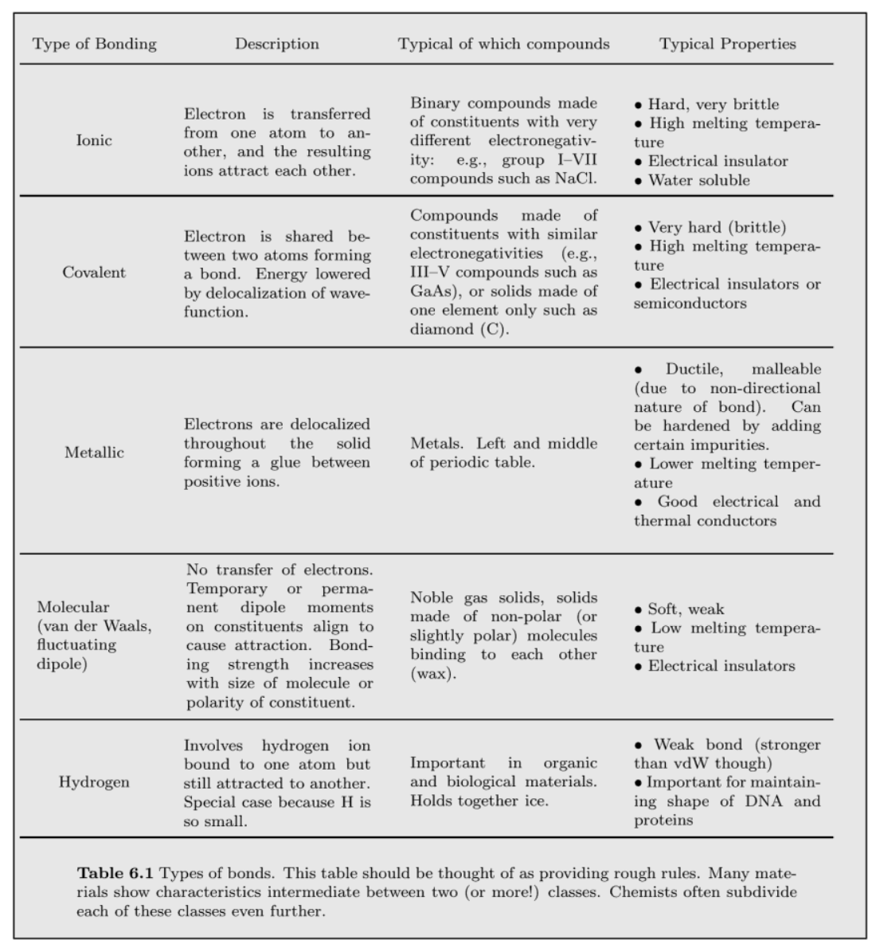
From Lecture 05
Lecture 08
Lecture 07 끝부분
Lecture 06 끝부분

Slide 46
Diatomic or Alternating Chain!

Slide 51
Addressing an earlier question!
No 11 electrons but 1 electron of Na

Slide 55
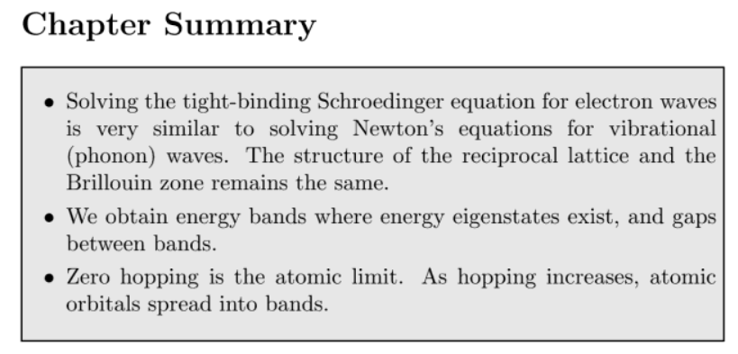
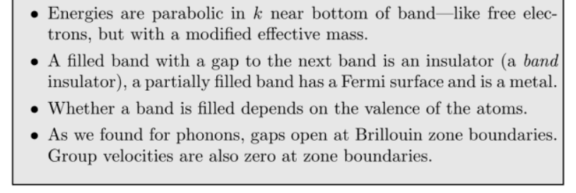
https://en.wikipedia.org/wiki/Mott_insulator
cf.) Mott insulator

