Slide 1
07. Microscopic View of Vibrations in Solids in One Dimension II: The Diatomic (Alternating) Harmonic Chain

Slide 8
…
독어? 영어?

Slide 12
Longest equation!

Slide 13
https://en.wikipedia.org/wiki/Determinant
https://en.wikipedia.org/wiki/Matrix_differential_equation

Slide 27
https://en.wikipedia.org/wiki/Eigenvalues_and_eigenvectors

Slide 30
From Lecture 14

Slide 40
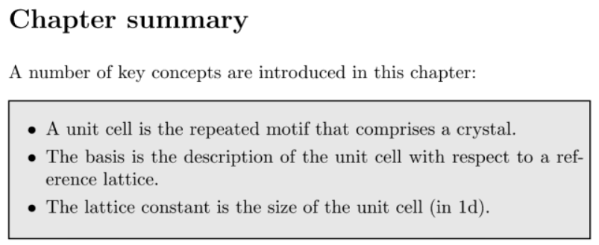
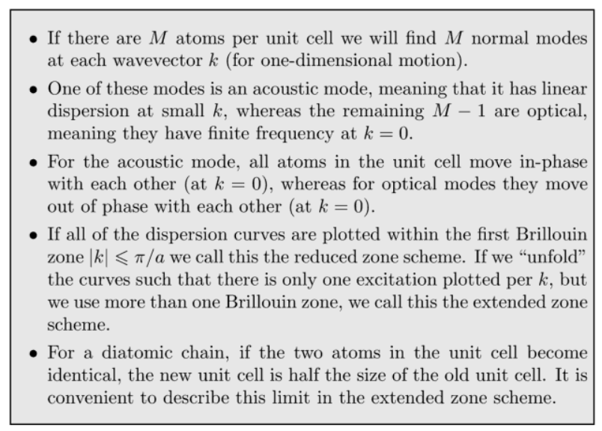

Slide 42
https://en.wikipedia.org/wiki/Electric_dipole_moment

Slide 45
For Fun!
https://www.geico.com/

