Slide 1
05. Chemistry in a Nutshell

Slide 2
https://en.wikipedia.org/wiki/Rydberg_constant

Slide 3
https://dictionary.cambridge.org/dictionary/german-english/aufbau
https://en.wikipedia.org/wiki/Aufbau_principle#Madelung_energy_ordering_rule
고유명사(사람이름) 아님!
↓

Slide 5
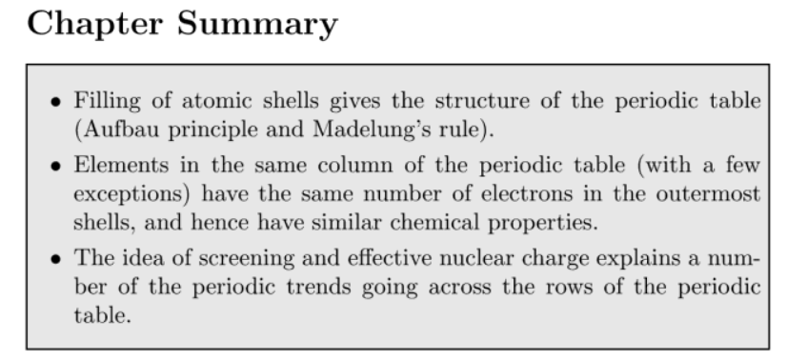

Slide 8
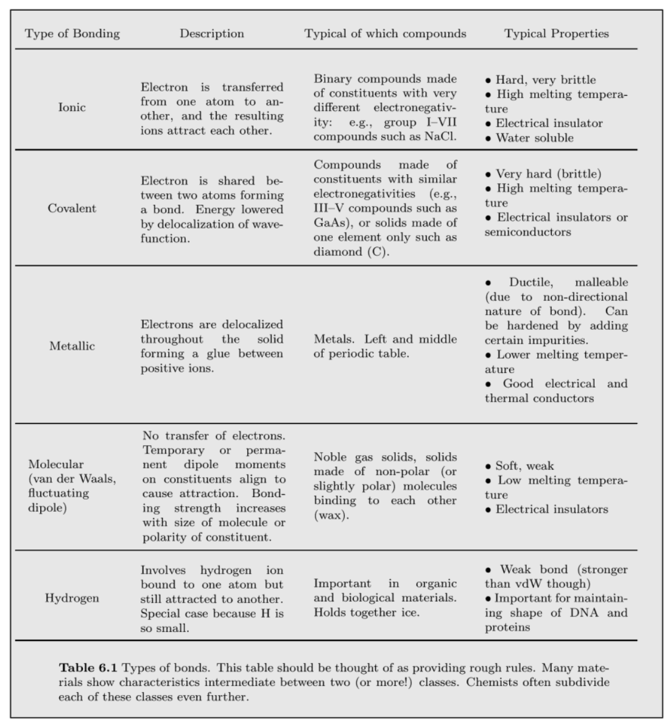
Lecture 08
Lecture 07 끝부분
Lecture 06 끝부분

Slide 9
https://en.wikipedia.org/wiki/Born%E2%80%93Haber_cycle

Slide 10
https://en.wikipedia.org/wiki/Madelung_constant

Slide 13
실제는 완벽한 스크리닝이 안되므로 underestimated
“Hydrogenic”

Slide 14
실제는 스크리닝이 있으므로 overestimated

Slide 16
https://en.wikipedia.org/wiki/Particle_in_a_box
Heisenberg Uncertainty principle!

Slide 18
참고) Lec. 8
Tight binding chain

Slide 19
https://en.wikipedia.org/wiki/J._Robert_Oppenheimer
https://en.wikipedia.org/wiki/Manhattan_Project
https://en.wikipedia.org/wiki/Born%E2%80%93Oppenheimer_approximation

Slide 21
Tight binding!

Slide 22
https://en.wikipedia.org/wiki/Variational_method_(quantum_mechanics)

Slide 23
orthogonal wave functions

Slide 29
https://en.wikipedia.org/wiki/Eigenvalues_and_eigenvectors

Slide 36
이온결합으로 되어 감!

