Slide 1
Recap: closed systems
SM for closed systems (no exchange of matter) obtained via Principle of Maximum Entropy
Maximise entropy subject to constraints using Lagrange multipliers – results in probability distribution and partition function that can be used to construct thermodynamics
Give physical meaning to Lagrange multipliers by considering equilibrium of multiple sub-systems brought into ‘loose’ contact
Considered isolated (microcanonical) and connected to heat bath (canonical), with application to classical ideal gas

Slide 2
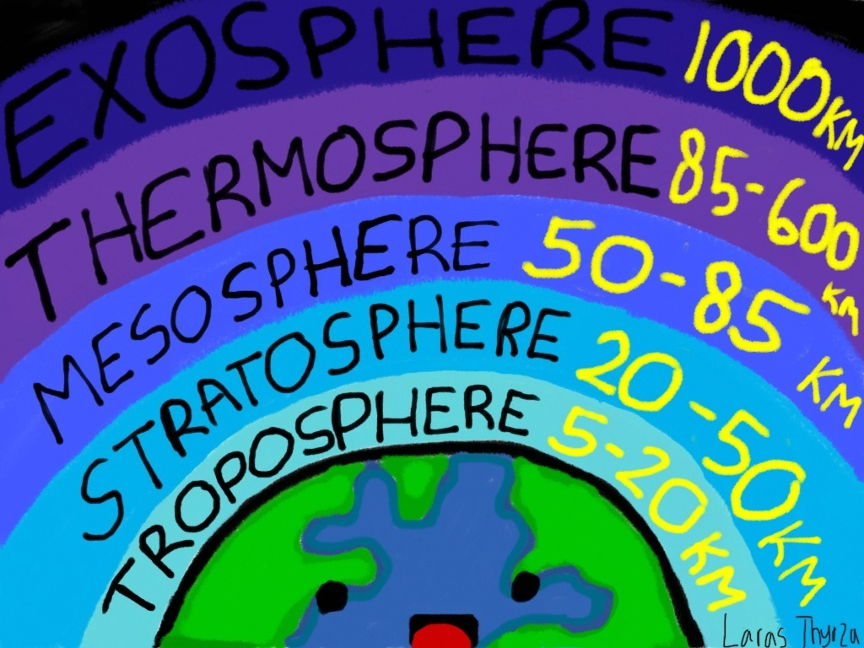
Inhomogeneous systems

Slide 3
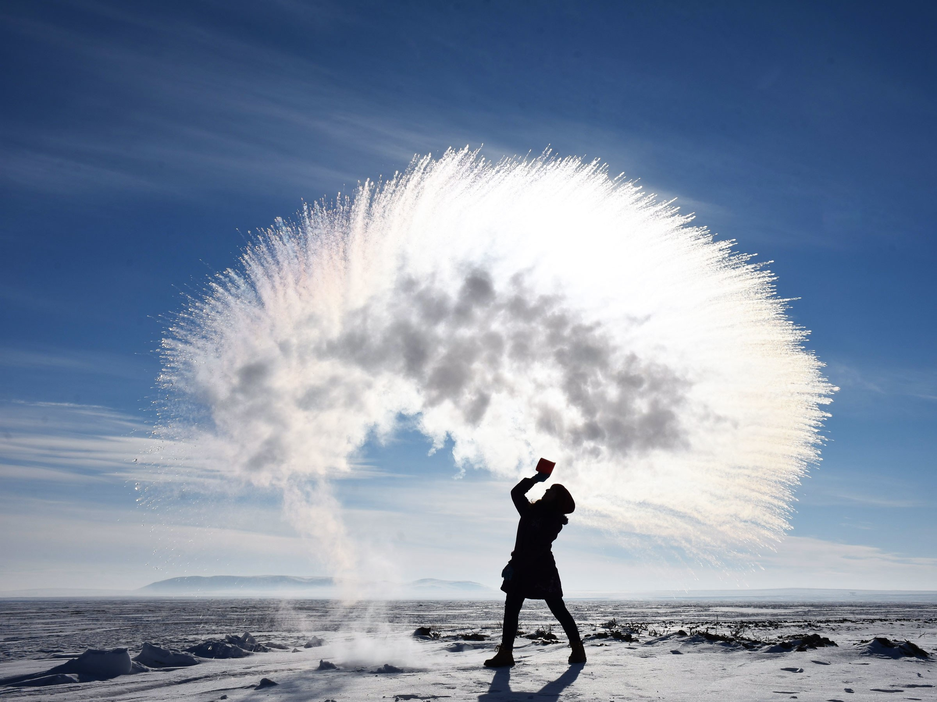
Multiphase systems

Slide 4
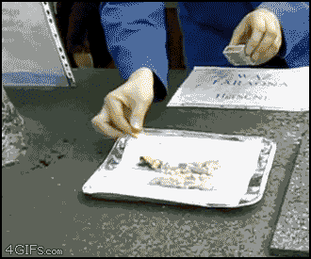
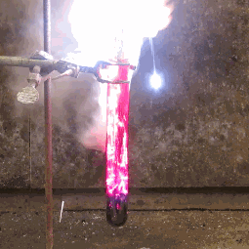
Multicomponent systems

Slide 5
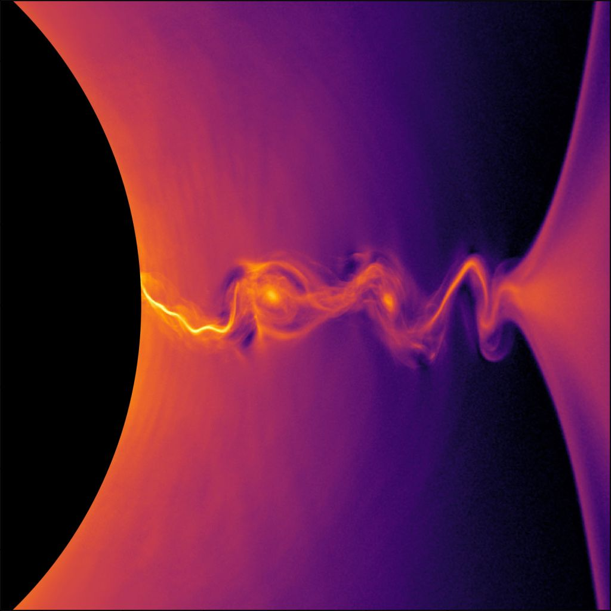
Systems without particle conservation

Slide 6
Recipe for constructing thermodynamics
Identify microstates and corresponding energies and particle numbers
Construct partition function $𝒵=?$
Calculate an equivalent free energy $Φ=−k_{B}T \text{ln} 𝒵=?$
Obtain pressure, entropy, etc. from $Φ$

Slide 7
Should entropy increase, decrease, or stay the same if more particles are added?
More particles => more microstates => more entropy

Slide 8
SM8: key ideas
Open systems have additional constraint on mean particle number
Results in grand canonical distribution and partition function with $E_{α}→E_{α}−μN_{α}$
Free energy replaced by grand potential $Φ=F−μ\overline{N}$ to construct thermodynamics
Particle equilibrium => equal chemical potentials for sub-systems

