Slide 1
Recap: classical, monatomic ideal gas immersed in a heat bath
Partition function for system with N indistinguishable particles is $Z=Z_{1}^{N}/N!$, with the single particle partition function $Z_{1}=V/λ_{th}^{3}$
Required continuum approximation, valid when $T≫T_{deg}/N^{2/3}$
Also assumed no more than one particle in each single-particle state, valid when $Ω≫N$; i.e., $T≫T_{deg}$

Slide 2
Recipe for constructing thermodynamics
Identify microstates and corresponding energy levels
Construct partition function $Z=\sum_{α}{e^{{−βE}_{α}}}$
Calculate the free energy $F=−k_{B}T \text{ln} Z=U−TS$
Obtain pressure, entropy, etc. from F

Slide 3
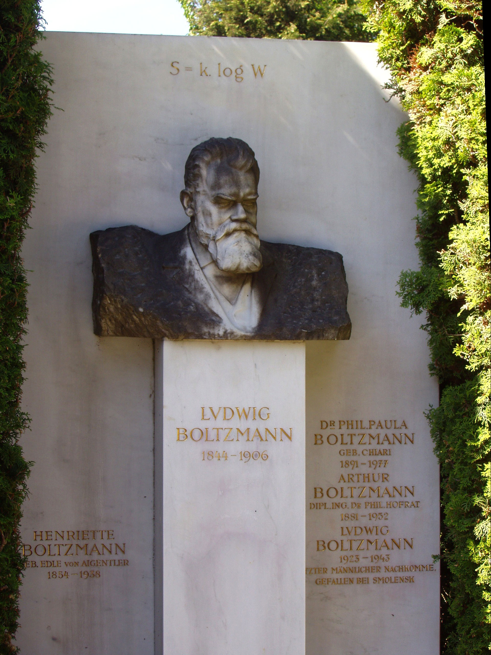

Slide 4
SM7: key ideas
Thermodynamics for classical ideal gas, constructed via SM, same as found in kinetic theory
Subtle, but fundamental, differences between Boltzmann and Gibbs-Shannon formulations of SM
Probabilities as frequencies (ergodic hypothesis) vs likelihoods
Apparent objectivity of Boltzmann’s approach vs apparent subjectivity of Gibbs-Shannon approach is perhaps misleading

