Slide 1
Recap
$\left\{p_{α}\right\}$ obtained via maximizing $S_{G}$ subject to constraints $\left\{F_{i}\left(\left\{p_{α}\right\}\right)=0\right\}$
Maximization done via Lagrange multipliers: ${d_{\left\{p_{α}\right\},{\{λ}_{i}\}}{\tilde{S}}_{G}=d}_{\left\{p_{α}\right\},{\{λ}_{i}\}}\left(S_{G}−\sum_{i}{λ_{i}F_{i}}\right)=0$
Thermal equilibrium: equal temperatures
Mechanical equilibrium: equal pressures
Dynamical equilibrium: translation + rigid body rotation

Slide 2
SM5: key ideas
Equilibrium requires $dS=0$
Stability requires $S$ be a maximum
Necessary condition for stability is, e.g., $∂^{2}S_{i}/∂^{2}U_{i}<0$
Thermal stability => heat capacity positive
Dynamical stability => temperature positive
Mechanical stability => pressure positive
Example: classical, monatomic, ideal gas

Slide 3
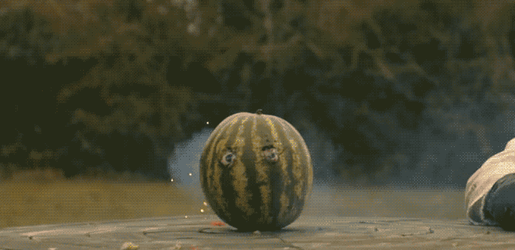
No negative temperature

Slide 4
SM5: key ideas
Equilibrium requires $dS=0$
Stability requires $S$ be a maximum
Necessary condition for stability is, e.g., $∂^{2}S_{i}/∂^{2}U_{i}<0$
Thermal stability => heat capacity positive
Dynamical stability => temperature positive
Mechanical stability => pressure positive
Example: classical, monatomic, ideal gas

Slide 5
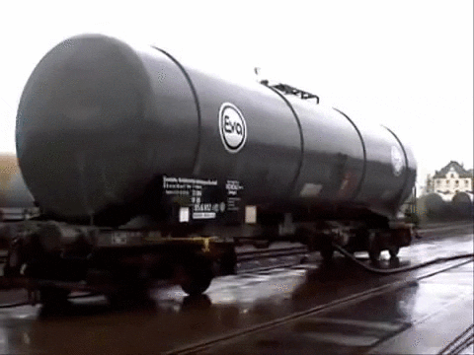
No negative pressure

Slide 6
SM5: key ideas
Equilibrium requires $dS=0$
Stability requires $S$ be a maximum
Necessary condition for stability is, e.g., $∂^{2}S_{i}/∂^{2}U_{i}<0$
Thermal stability => heat capacity positive
Dynamical stability => temperature positive
Mechanical stability => pressure positive
Example: classical, monatomic, ideal gas

