Slide 1
Recap
$\left\{p_{α}\right\}$ obtained via maximizing $S_{G}$ subject to constraints $\left\{F_{i}\left(\left\{p_{α}\right\}\right)=0\right\}$
Maximization done via Lagrange multipliers: $d_{\left\{p_{α}\right\},{\{λ}_{i}\}}\left(S_{G}−\sum_{i}{λ_{i}F_{i}}\right)=0$
${S=k_{B}S}_{G}$, $β=1/k_{B}T$, $P=\sum_{α}{p_{α}(∂E_{α}/∂V)}$
Thermal equilibrium for composite systems => entropy additive, equal ‘temperatures’ (or $β(T)$)
Started considering more complicated composite system…

Slide 2
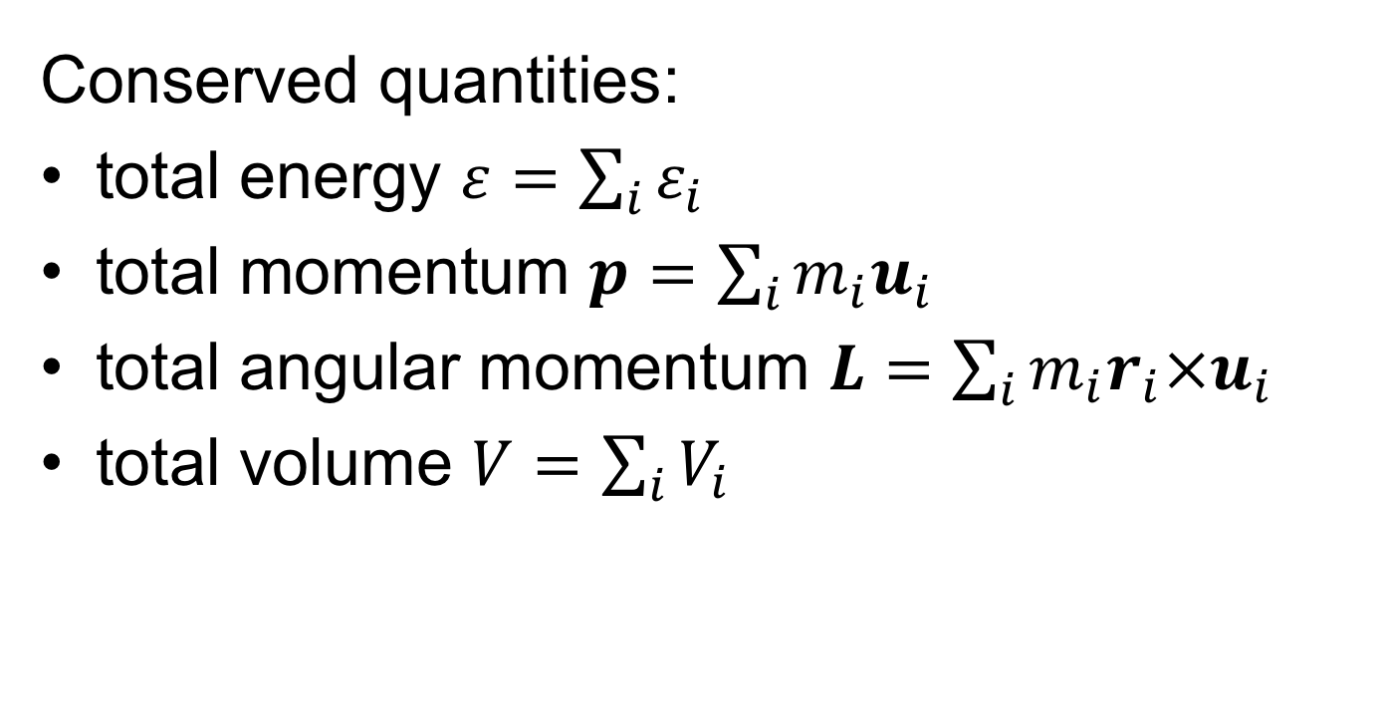
$i^{th}$ subsystem
insulated barrier
Conserved quantities:
total energy $ε=\sum_{i}{ε_{i}}$
total momentum $p=\sum_{i}{m_{i}u_{i}}$
total angular momentum $L=\sum_{i}{m_{i}r_{i}×u_{i}}$
total volume $V=\sum_{i}{V_{i}}$

Slide 3
What do you expect to happen in mechanical equilibrium?

Slide 4
What do you expect to happen in mechanical equilibrium?
$V_{init}^{(1)}=$ $V_{init}^{(2)}$
$$P_{init}^{(1)}$$
$$P_{init}^{(2)}$$

Slide 5
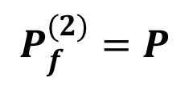
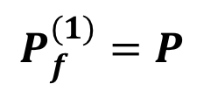
What do you expect to happen in mechanical equilibrium?
If $P_{init}^{(1)}$ > $P_{init}^{(2)}$
$$P_{f}^{(1)}=P$$
$$P_{f}^{(2)}=P$$

Slide 6
Dynamical
equilibrium

Slide 7
SM4: key ideas
Beyond the canonical ensemble: extension to mechanical/dynamical equilibria
Entropy = function of variables appearing in constraints
Thermal equilibrium: equal temperatures
Mechanical equilibrium: equal pressures
Dynamical equilibrium: translation + rigid body rotation

