Slide 1
Recap
$\left\{p_{α}\right\}$ obtained via maximizing $S_{G}$ subject to constraints $\left\{F_{i}\left(\left\{p_{α}\right\}\right)=0\right\}$
Maximization done via Lagrange multipliers: $d_{\left\{p_{α}\right\},{\{λ}_{i}\}}\left(S_{G}−\sum_{i}{λ_{i}F_{i}}\right)=0$
Checked for isolated system (microcanonical ensemble) and got equal probabilities
Canonical ensemble = identical realizations of system with average energy U fixed
Probability distribution = Gibbs distribution

Slide 2
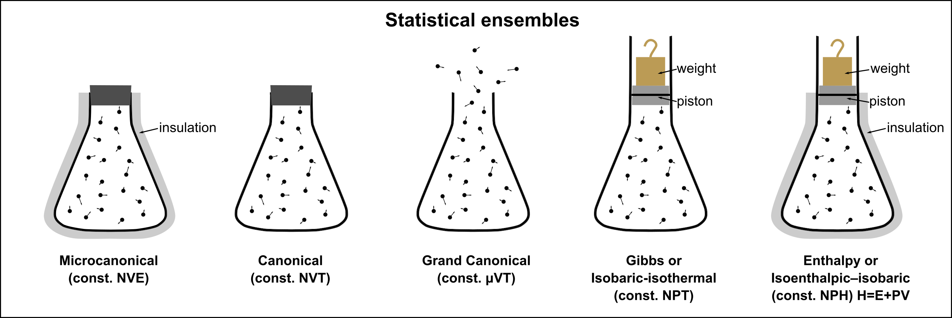
Microcanonical vs canonical ensembles
image from wikipedia

Slide 3
SM3: key ideas
Relationship of Gibbs entropy and beta to thermodynamic entropy and temperature
Expression for free energy in terms of partition function
Additivity of entropy
Equilibria for composite systems (thermal + mechanical + dynamical)

