Slide 1
Recap
Given the free energy F = U – TS, can calculate all thermodynamic quantities of interest
Macro obtained from micro via statistical averages (again) – need probability distributions
Probability distributions obtained via Principle of Maximum Entropy:
Assign probabilities in ‘fairest’ way possible with information provided
Multiplicity = number of ways to assign a set of probabilities to a given microstate
Largest multiplicity => most likely
Same as maximizing entropy

Slide 2
SM2: key ideas
Entropy = measure of ignorance
Maximize entropy subject to constraints via method of Lagrange multipliers
Important examples:
Microcanonical ensemble (isolated system)
Canonical ensemble (system connected to a heat bath)
Connection to thermodynamics

Slide 3
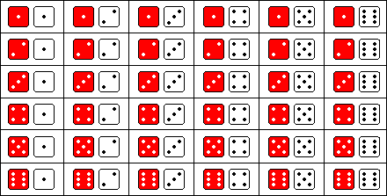
A statistical ensemble is an idealized construct consisting of many identical copies of the same system, each representing a possible microstate

Slide 4
Different constraints lead to different ensembles
Example constraint: sum = 4

Slide 5
SM2: key ideas
Entropy = measure of ignorance
Maximize entropy subject to constraints via method of Lagrange multipliers
Important examples:
Microcanonical ensemble (isolated system)
Canonical ensemble (system connected to a heat bath)
Connection to thermodynamics

