Slide 1
SM1: key ideas
Given the free energy F = U – TS, can calculate all thermodynamic quantities of interest
Distinction between microstates and macrostates; statistical ensembles
Macro obtained from micro via statistical averages (again) – need probability distributions
Probability distributions obtained via Principle of Maximum Entropy:
Assign probabilities in ‘fairest’ way possible with information provided

Slide 2
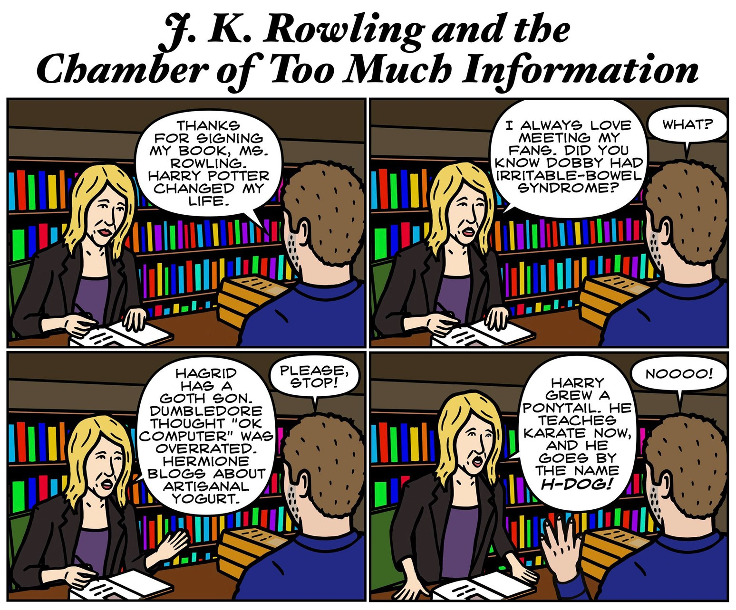
Aim is to calculate F(V,T) with minimal information about microphysics
© The New Yorker

Slide 3
Counting microstates and macrostates
Flip N 2-sided coins and count total number of heads/tails
How many microstates and macrostates are available to the system?
2^{N} microstates: (H/T, H/T, H/T, …, H/T); N macrostates (1 H, 2H, 3H, …, NH)

Slide 4
SM1: key ideas
Given the free energy F = U – TS, can calculate all thermodynamic quantities of interest
Distinction between microstates and macrostates; statistical ensembles
Macro obtained from micro via statistical averages (again) – need probability distributions
Probability distributions obtained via Principle of Maximum Entropy:
Assign probabilities in ‘fairest’ way possible with information provided

