Slide 1
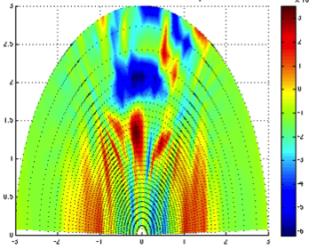
Kinetic Theory http://www-thphys.physics.ox.ac.uk/people/mbarnes/teaching/stat_phys/index.html
Michael Barnes michael.barnes@physics.ox.ac.uk
v
v||

Slide 2
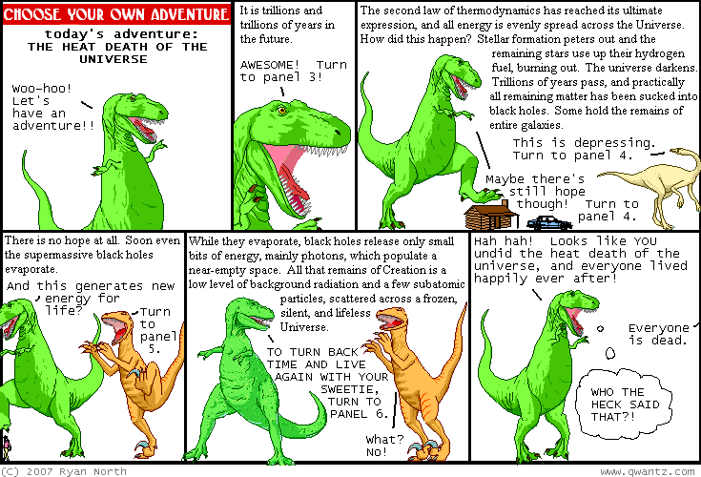
Universal thermodynamic equilibrium

Slide 3
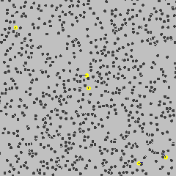
Particle tracking: deterministic?

Slide 4

particle tracking
d
$$ℓ$$

Slide 5
particle tracking
d
$$ℓ$$

Slide 6
particle tracking
d
$$ℓ$$

Slide 7

particle tracking
$$θ_{0}$$

Slide 8
particle tracking
d
$$ℓ$$

Slide 9


particle tracking
d/2
$$θ_{1}$$
$$δ$$
$$θ_{0}$$

Slide 10
KT1: key ideas
Tracking individual particles hopeless; must rely on statistical treatment
The aim (in this course) of kinetic theory is to determine macroscopic behavior of classical ideal gas:
  N identical point particles (hard spheres) that interact only through elastic collisions
  Positions/velocities assumed to be random variables
Micro related to macro via statistical averages
Statistical averages are very good approximation in thermodynamic limit

