Slide 1
Constraining neutron star properties with perturbative QCD Aleksi Vuorinen University of Helsinki
University of Oxford
23.2.2015
Main reference: Kurkela, Fraga, Schaffner-Bielich, AV, ApJ 789 (1402.6618)

Slide 2
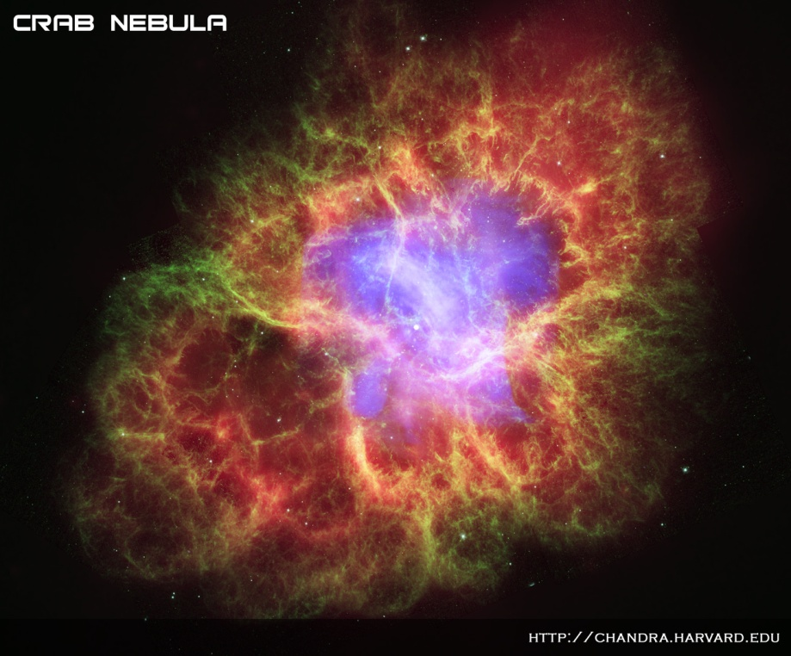
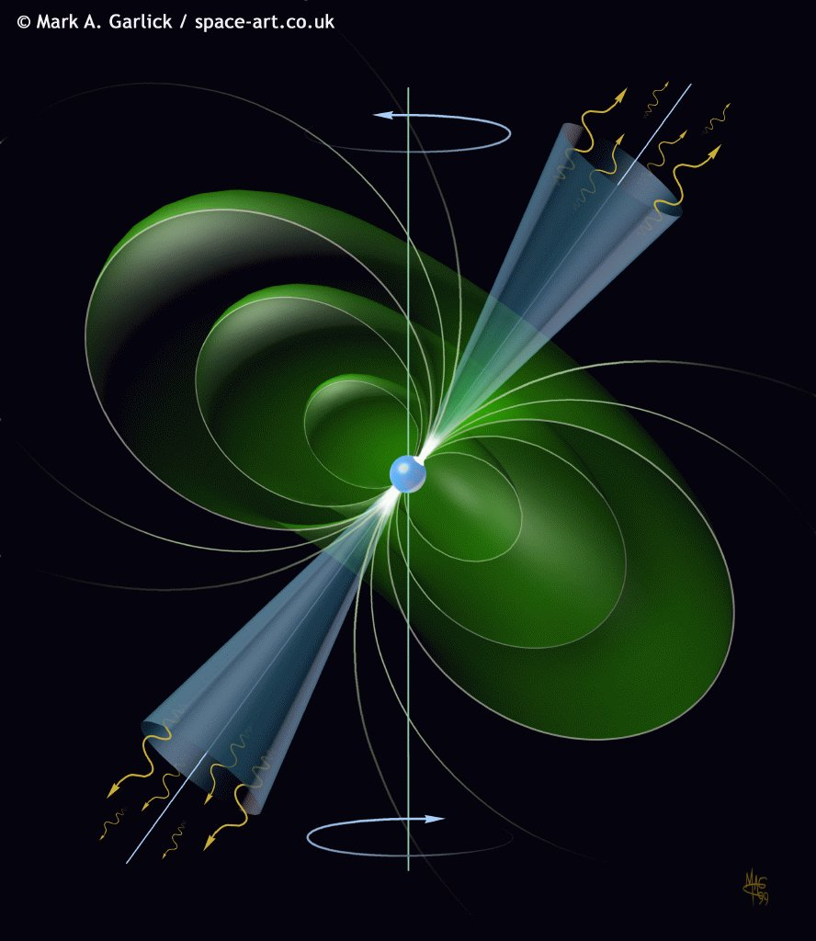
When a hydrogen burning star runs out of fuel:
White dwarf
Supernova explosion
Gravitational collapse into BH
Gravitational collapse into…

Slide 3
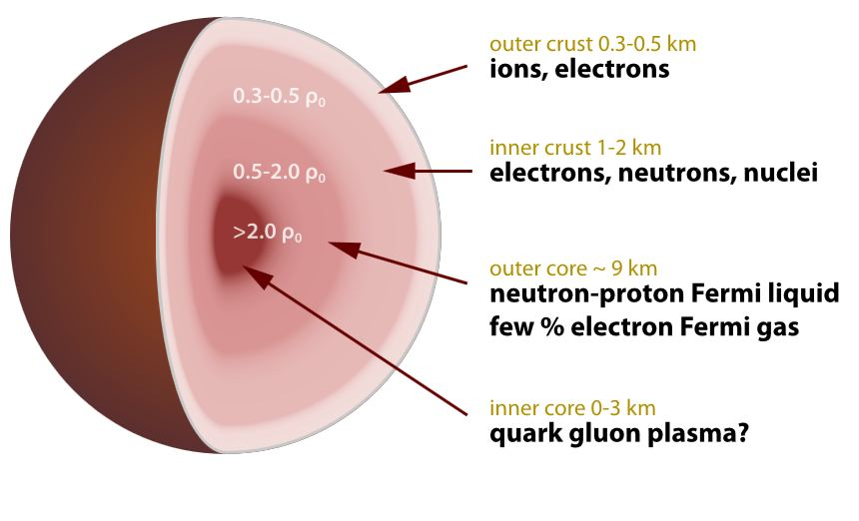
Notes:
And neutron stars

Slide 4
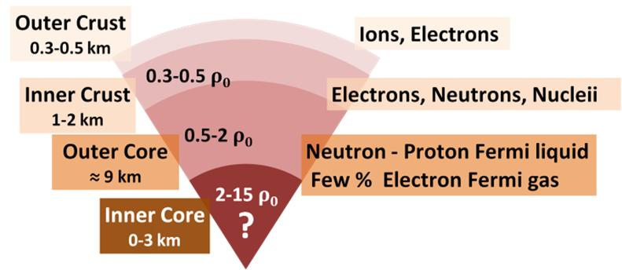
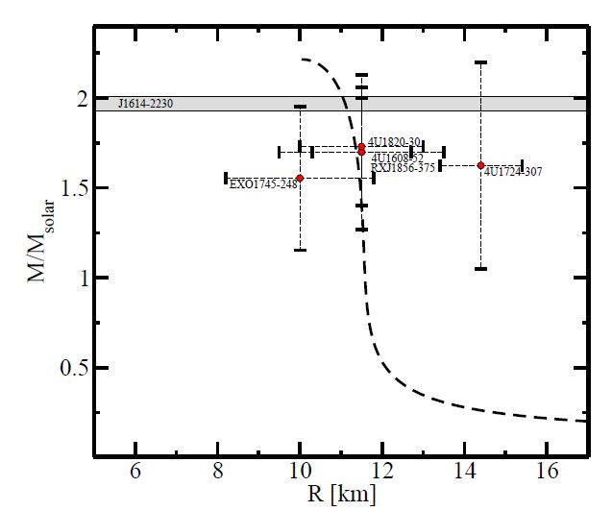
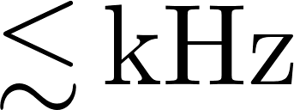
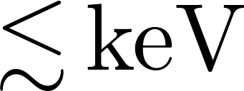
Classic problem in nuclear astrophysics:
Predict composition and main properties of neutron stars
Characteristics:
Masses
Radii
Spin frequencies
Temperature

Slide 5
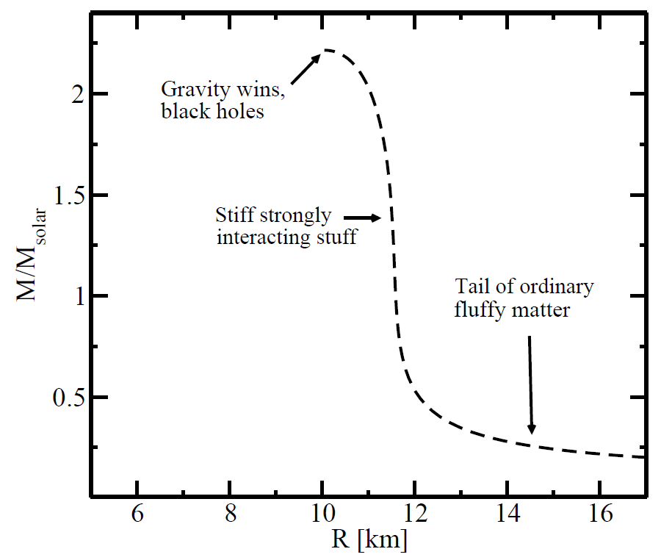
Theory challenge: Find EoS of nuclear/quark matter that is
Cold:
Electrically neutral:
In beta equilibrium:
and compare to observations.
Ultimate question: Is there quark matter inside the stars?

Slide 6
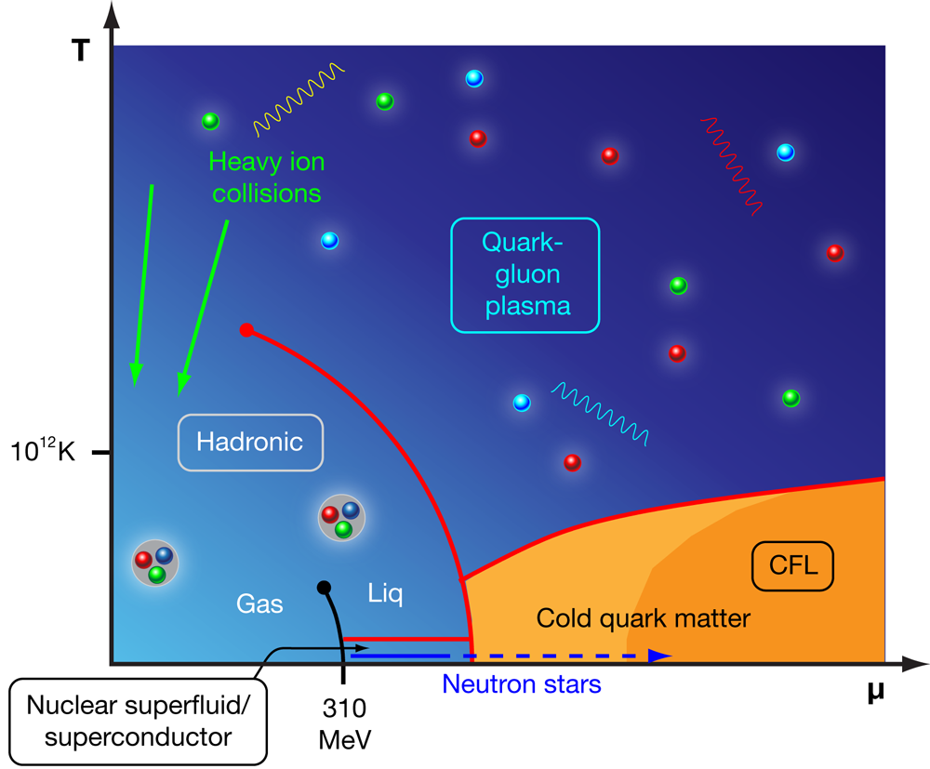

Slide 7
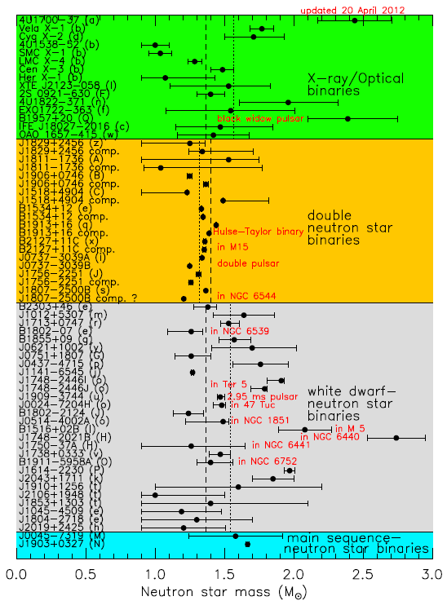
N.B.1: Fast progress on the observational side both in stellar masses and radii, the latter being a much harder problem.
N.B.2: Stars characterized also by many other observables (cooling rates, glitches in spinning frequencies,...), sensitive to subtler (e.g. transport) properties of the matter than the EoS.

Slide 8
What is known about the EoS: Limits of low and high densities
Entering no man’s land: Interpolating polytropes
Implications for neutron star physics: MR-relations and beyond

Slide 9
What is known about the EoS: Limits of low and high densities
Entering no man’s land: Interpolating polytropes
Implications for neutron star physics: MR-relations and beyond

Slide 10
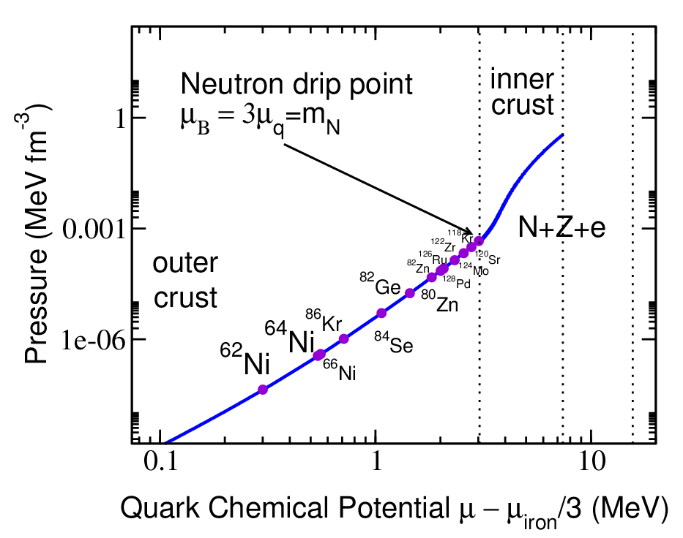
Neutron gas with nuclei and electrons
NN interactions important for collective properties; modeled via experimentally highly constrained ‘potential models’
Eventually need 3N interactions, boost corrections,…
Lattice of increasingly neutron rich nuclei in electron sea; pressure dominated by that of the electron gas
At zero pressure nuclear ground state

Slide 11
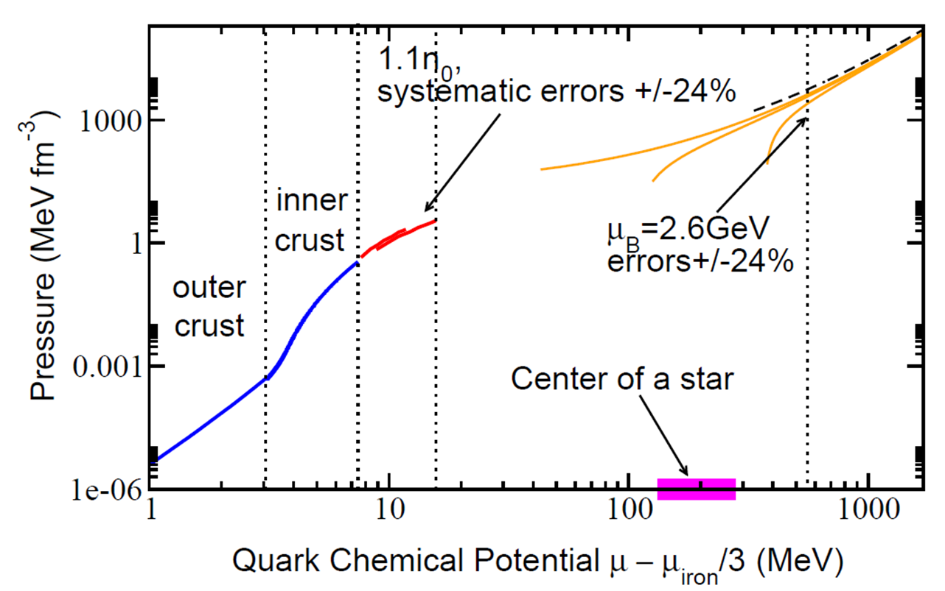
Closer to saturation density , need many-body calculations within Chiral Effective Theory, including 3N and 4N interactions
At , errors - mostly due to uncertainties in effective theory parameters
State-of-the-art NNNLO Tews et al., PRL 110 (2013), Hebeler et al., APJ 772 (2013)
Notes:
Star centers at several 100 MeV. What can we do at higher density?

Slide 12
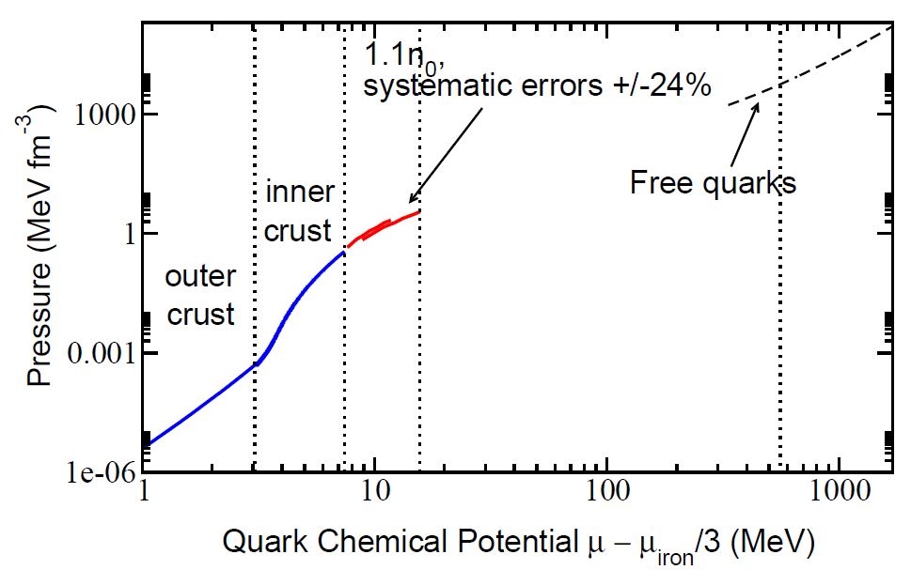
Asymptotic freedom gives asymptotic behavior. However,…
At interesting densities system strongly interacting but no lattice QCD available
Quark pairing important and very nontrivial to account for: Even phase structure unknown

Slide 13
How about building a bridge from the high density side?

Slide 14
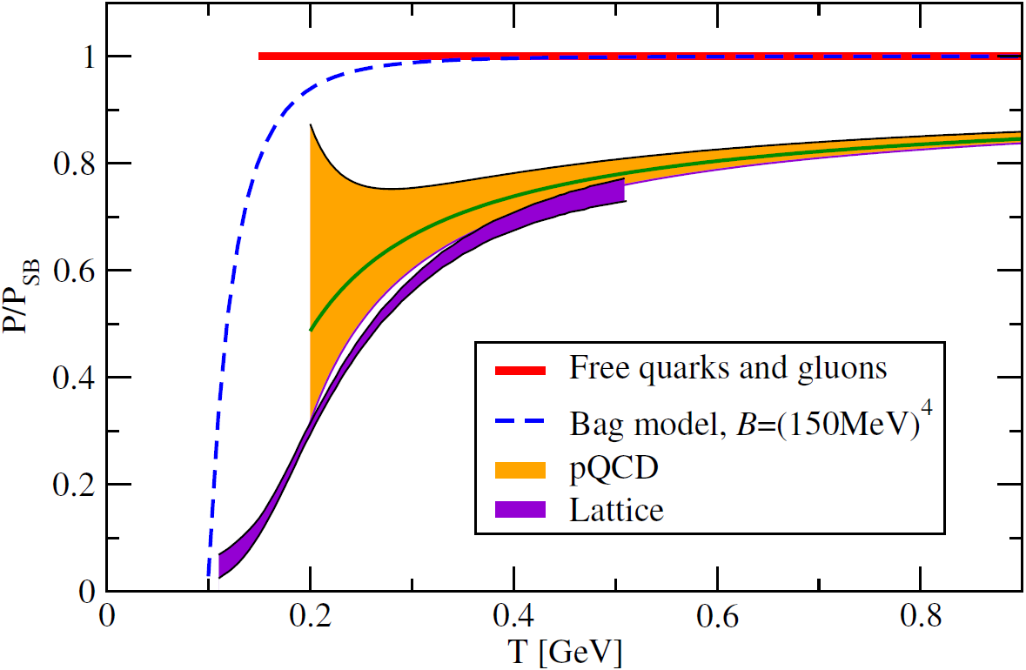

Slide 15
Quantitative error estimates from renormalization / resolution scale dependence

Slide 17
Leading order at zero temperature: Gas of noninteracting quarks

Slide 18
Leading order at zero temperature: Gas of noninteracting quarks

Slide 19
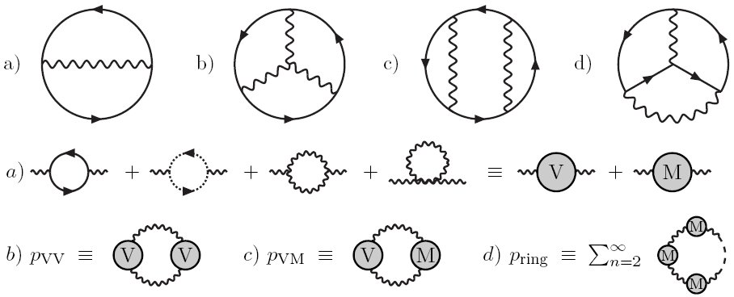
NLO and NNLO: Vacuum diagrams and ring resummation
Kurkela, Romatschke, Vuorinen, PRD 81 (2010)

Slide 20
NLO and NNLO: Vacuum diagrams and ring resummation
Method: Reduction to phase space integrals over vacuum amplitudes via cutting of fermion propagators

Slide 21
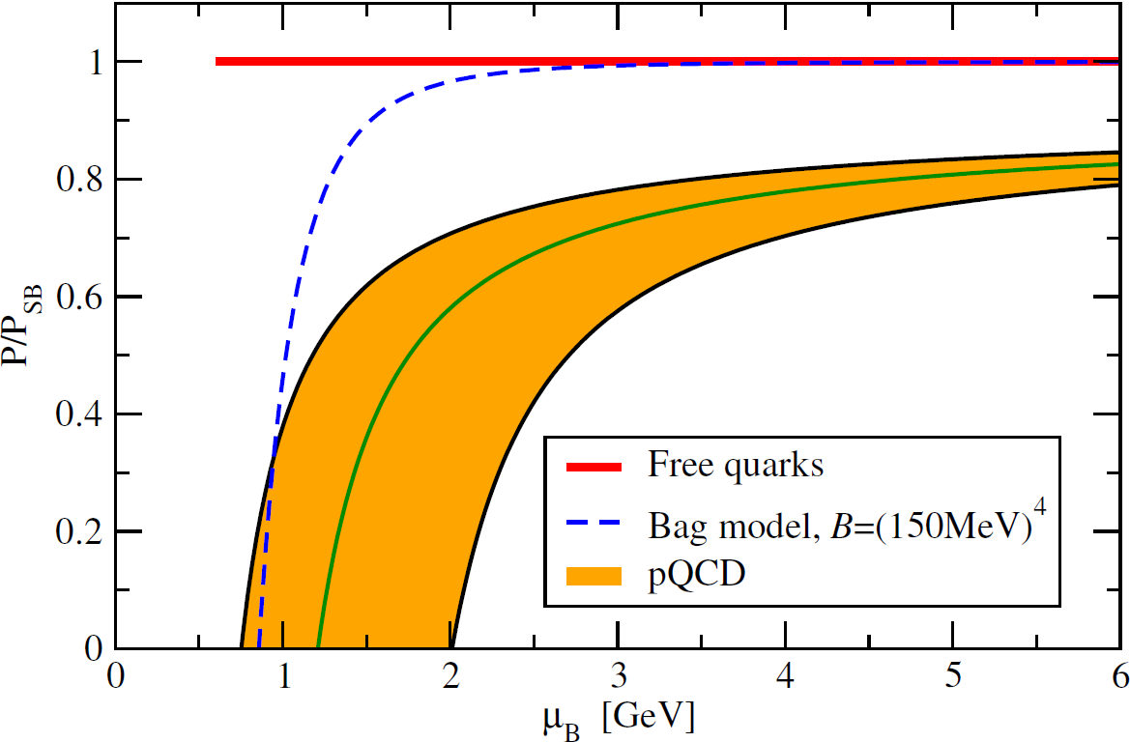
NLO and NNLO: Vacuum diagrams and ring resummation
Main sources of uncertainty:
Renormalization scale dependence
Running of
Value of strange quark mass

Slide 22
NLO and NNLO: Vacuum diagrams and ring resummation

Slide 24
N.B. Star cores almost perturbative!

Slide 25
What is known about the EoS: Limits of low and high densities
Entering no man’s land: Interpolating polytropes
Implications for neutron star physics: MR-relations and beyond

Slide 26
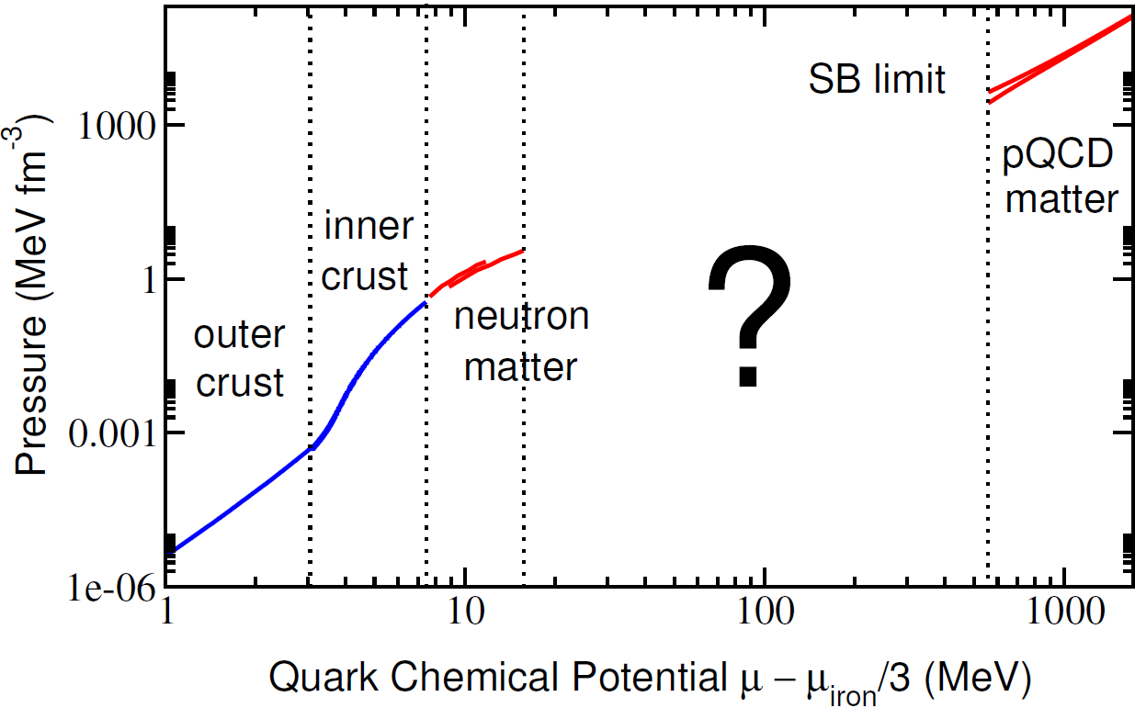
Two choices:
Phenomenological models (cf. MIT bag)
Controlled interpolation between known limits

Slide 27
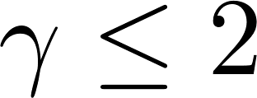
Quantify ignorance using piecewise polytropic EoSs, , and varying all parameters. Do this requiring
Smooth matching to nuclear and quark matter EoSs
Smoothness: Continuity of and when matching monotropes (can be relaxed)
Subluminality - asymptotically equivalent to
Ability to support a two solar mass star
Hebeler, Lattimer, Pethick, Schwenk, APJ 773 (2013)
Kurkela, Fraga, Schaffner-Bielich, Vuorinen, APJ 789 (2014)
Notes:
Typical parametrization when no idea of how function behaves

Slide 28
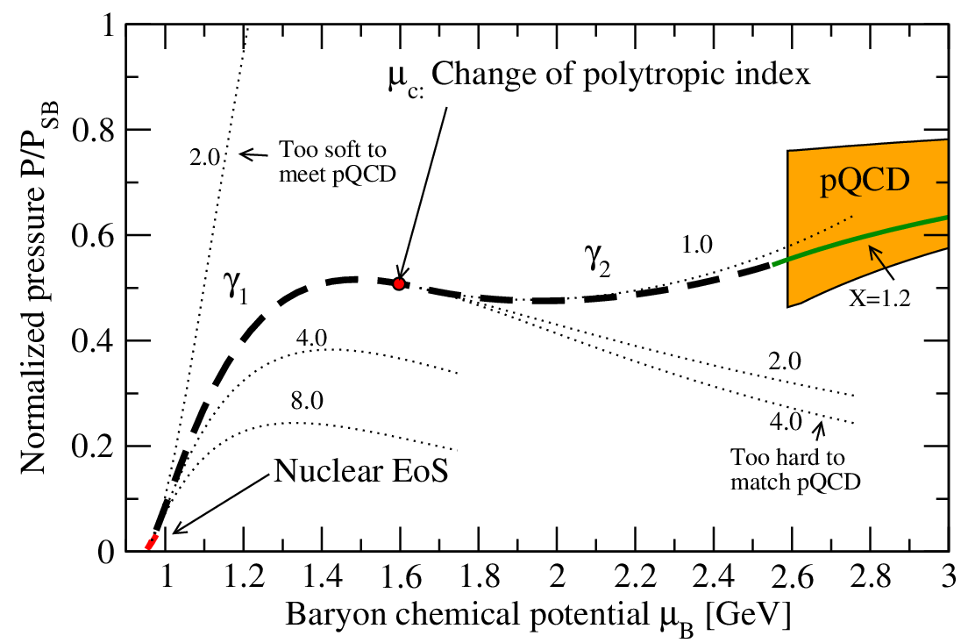
Solutions exist for

Slide 29
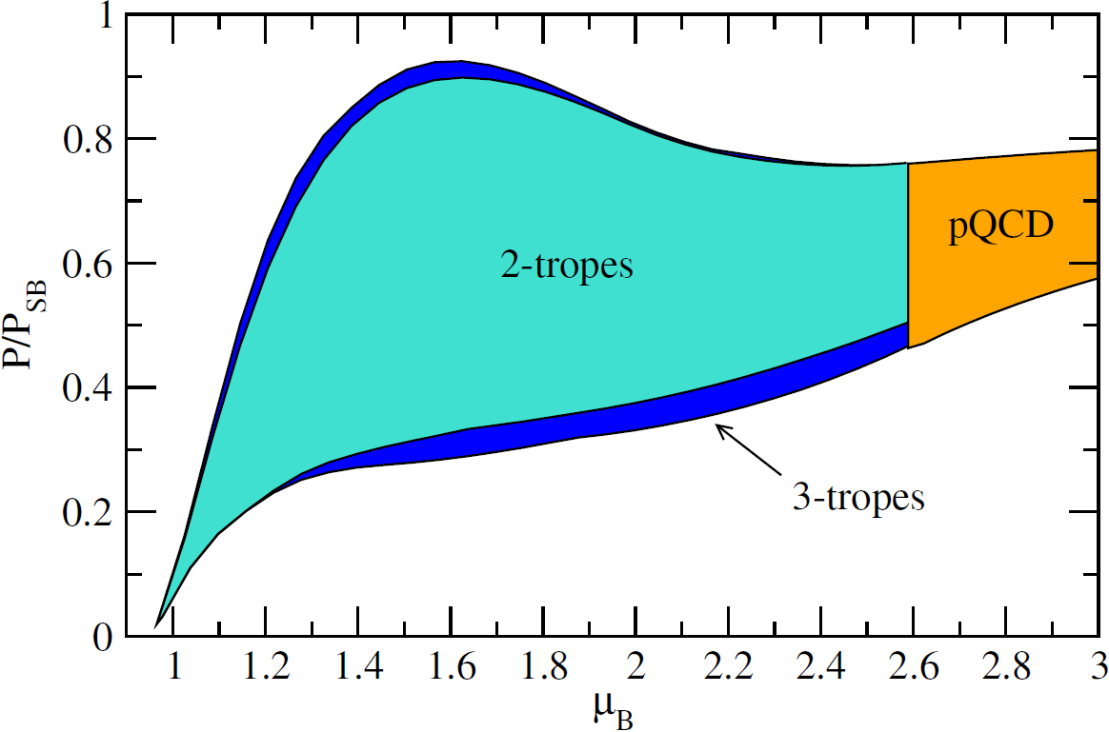
The minimum number of monotropes required for matching – and apparently also sufficient – is 2

Slide 30
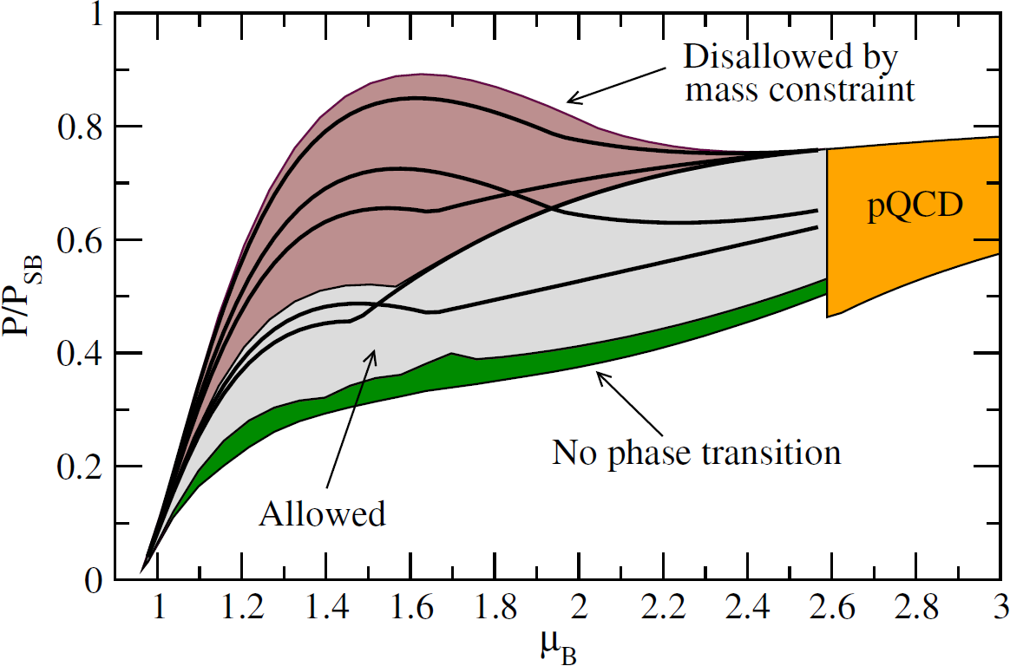
Two solar mass constraint significant. On the other hand, allowing for a 1st order phase transition (nonzero `latent heat’) only leads to a smaller region of allowed EoSs

Slide 31
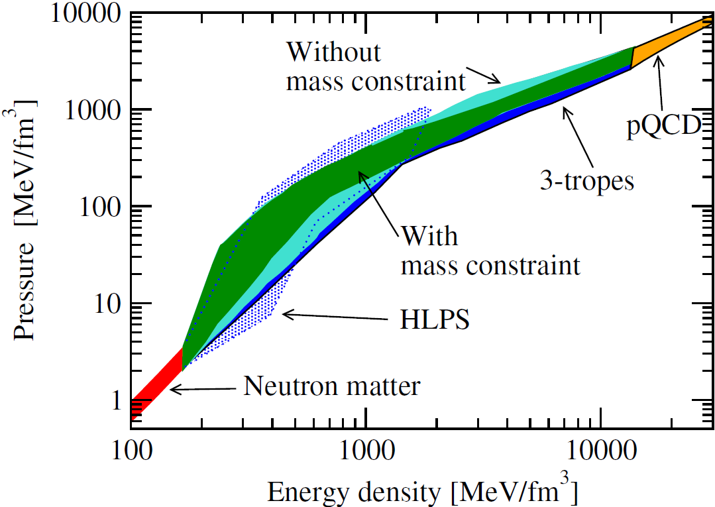
HLPS [Hebeler, Lattimer, Pethick, Schwenk, APJ 773 (2013)] without high-density constraint

Slide 32
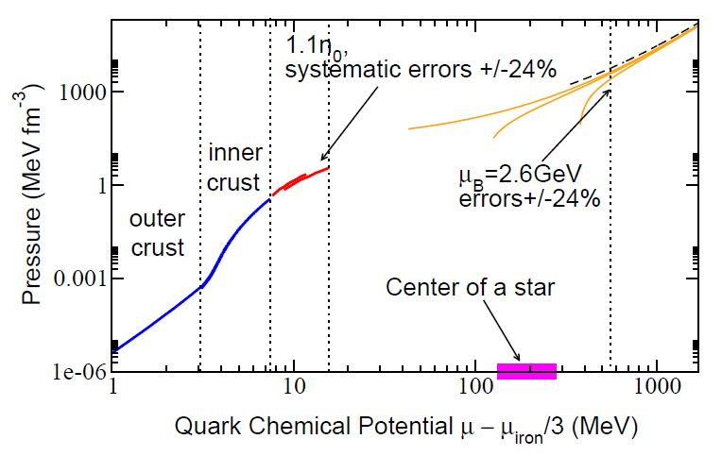
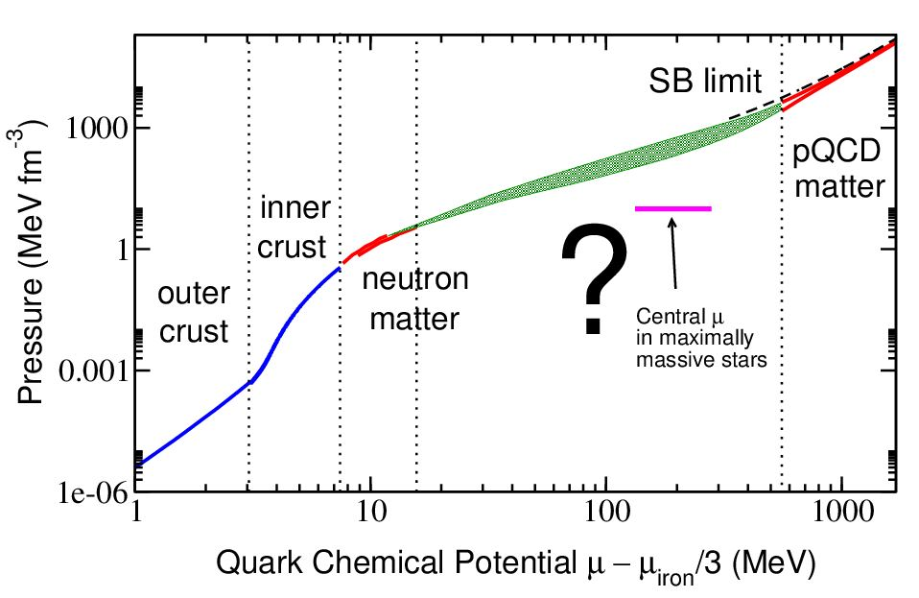

Slide 33
What is known about the EoS: Limits of low and high densities
Entering no man’s land: Interpolating polytropes
Implications for neutron star physics: MR-relations and beyond

Slide 34
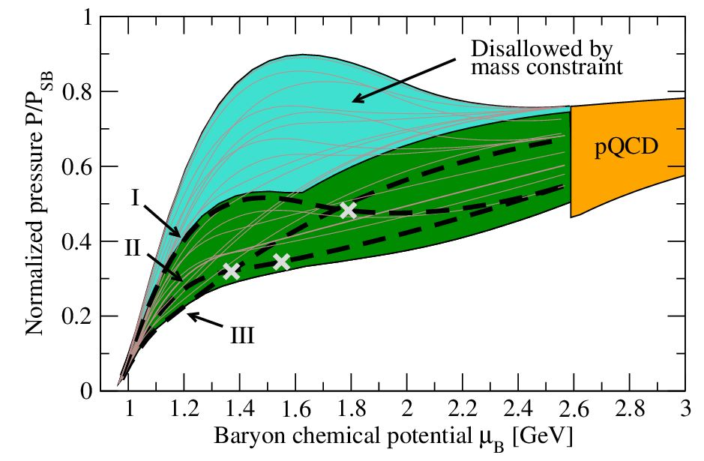

Slide 35
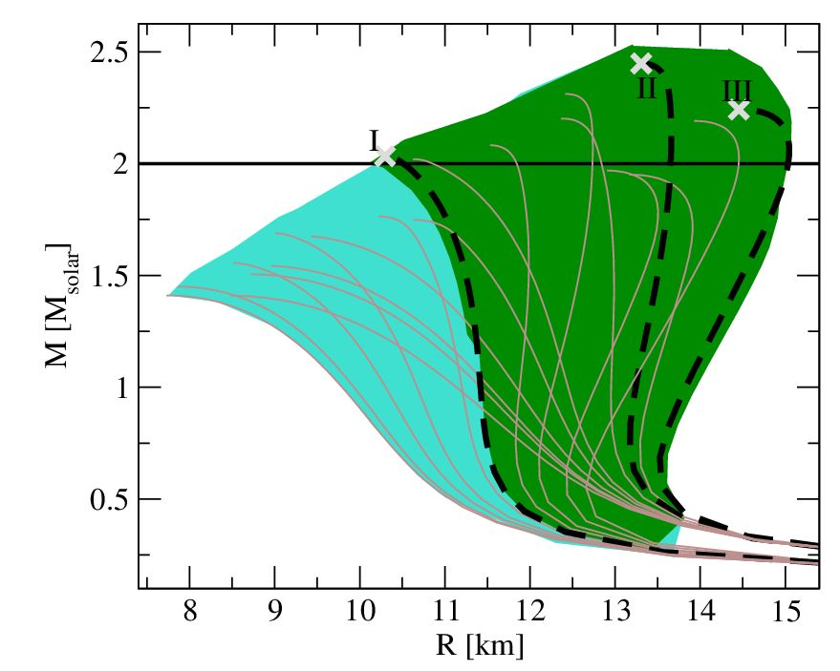
Maximal masses up to ! Central densities
Large reduction in EoS uncertainty due to tension from mass constraint: Large stellar masses require stiff EoS, matching to pQCD soft
EoS uncertainty down to 30% at all densities

Slide 36
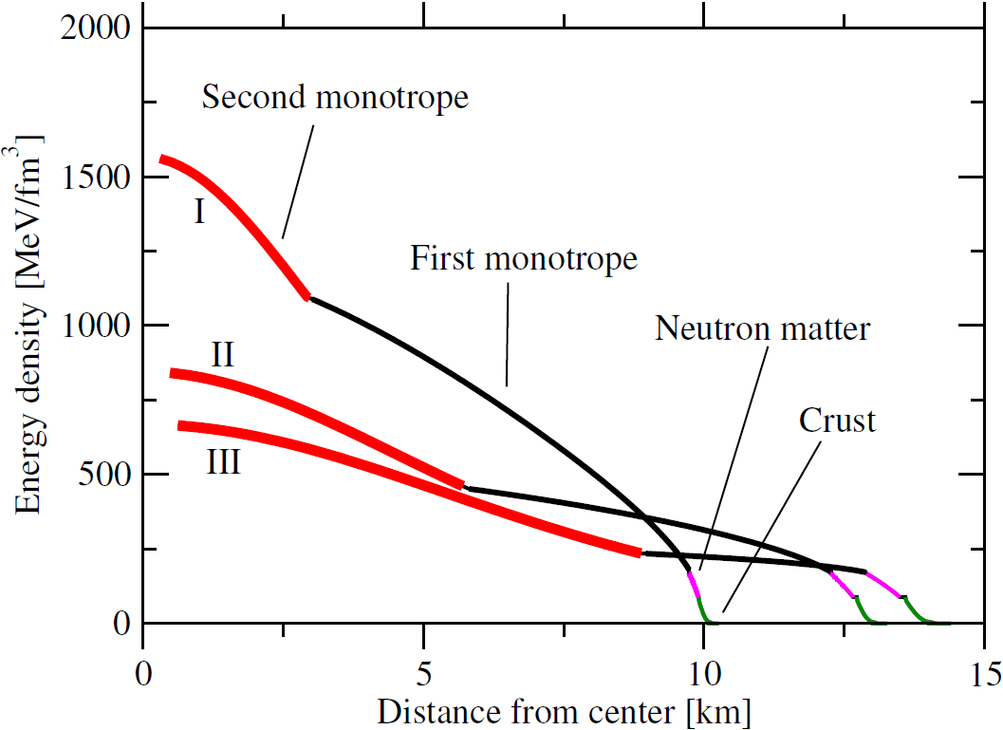
Nuclear matter EoS only used very close to star surface – yet important effects from matching

Slide 37
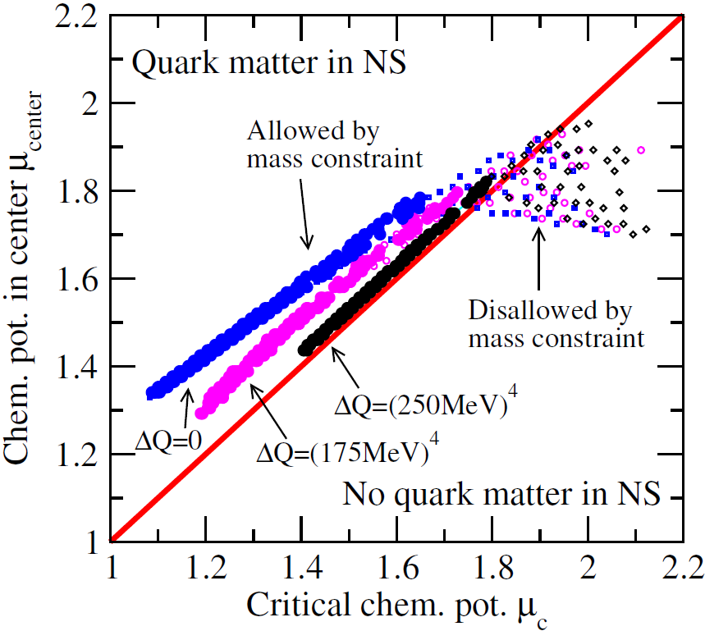
Interpreting polytrope matching point ( ) as phase transition to quark matter, witness strong correlation between and the chemical potential at the center of a maximally massive star.
The stronger the transition, the less room for quark matter. Even then the pQCD result crucial for constraining the EoS!

Slide 38
Final thoughts
Figuring out the properties – and identity – of neutron star matter is hard…
but not impossible if you systematically use 1st principles results at low and high density
Discovering massive stars places strong constraints on nuclear matter EoS due to tension with soft pQCD pressure
pQCD constraint useful even if no quark matter present in stars

