Slide 1
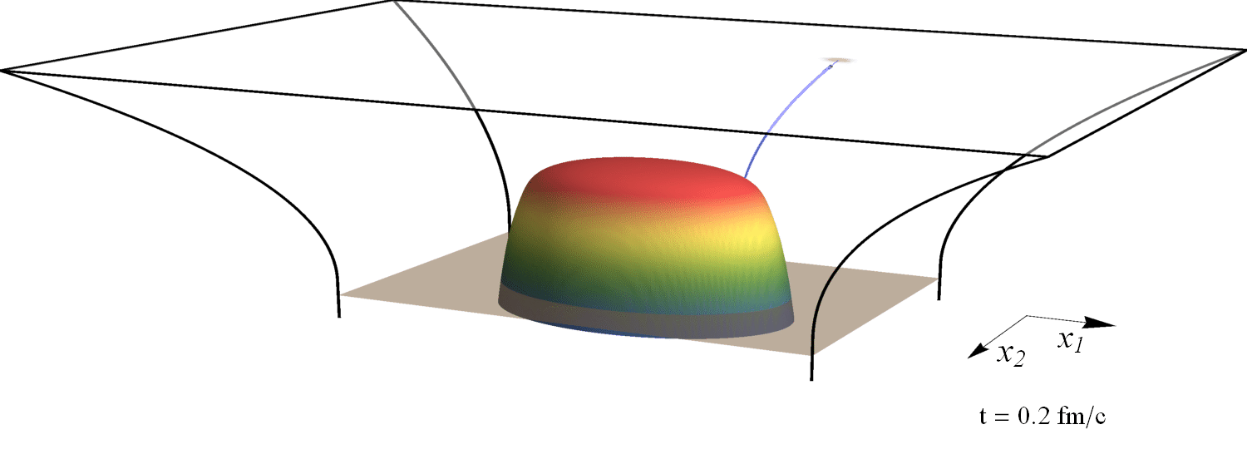
Recent holographic heavy ion collisions: jets and hydrodynamisation
Towards quantitative results from holography
Based on work with Krishna Rajagopal, Andrey Sadofyev, Jasmine Brewer and Saso Grozdanov
References: 1501.04952, 1602.04187 (PRL), 1610.08976
Wilke van der Schee
Holography seminar, Oxford
28 February 2017
(slowed down by 10²³)

Slide 2
Outline
Wilke van der Schee, MIT
Holography to model QCD
AdS/CFT: first principle non-perturbative QFT computations
Limitations: QCD(-like) theory with intermediate coupling is hard
Two simple models
Colliding lumps of energy in super-Yang-Mills theory
Obtain early hydrodynamics + rapidity distribution
Finite coupling corrections
Shoot ensemble of jets through expanding and cooling sQGP
Extract influence QGP on jet opening angle distribution
An outlook
Time permitting: small systems
More refined models, more realistic phenomenology
Notes:
Many states + linearized

Slide 3
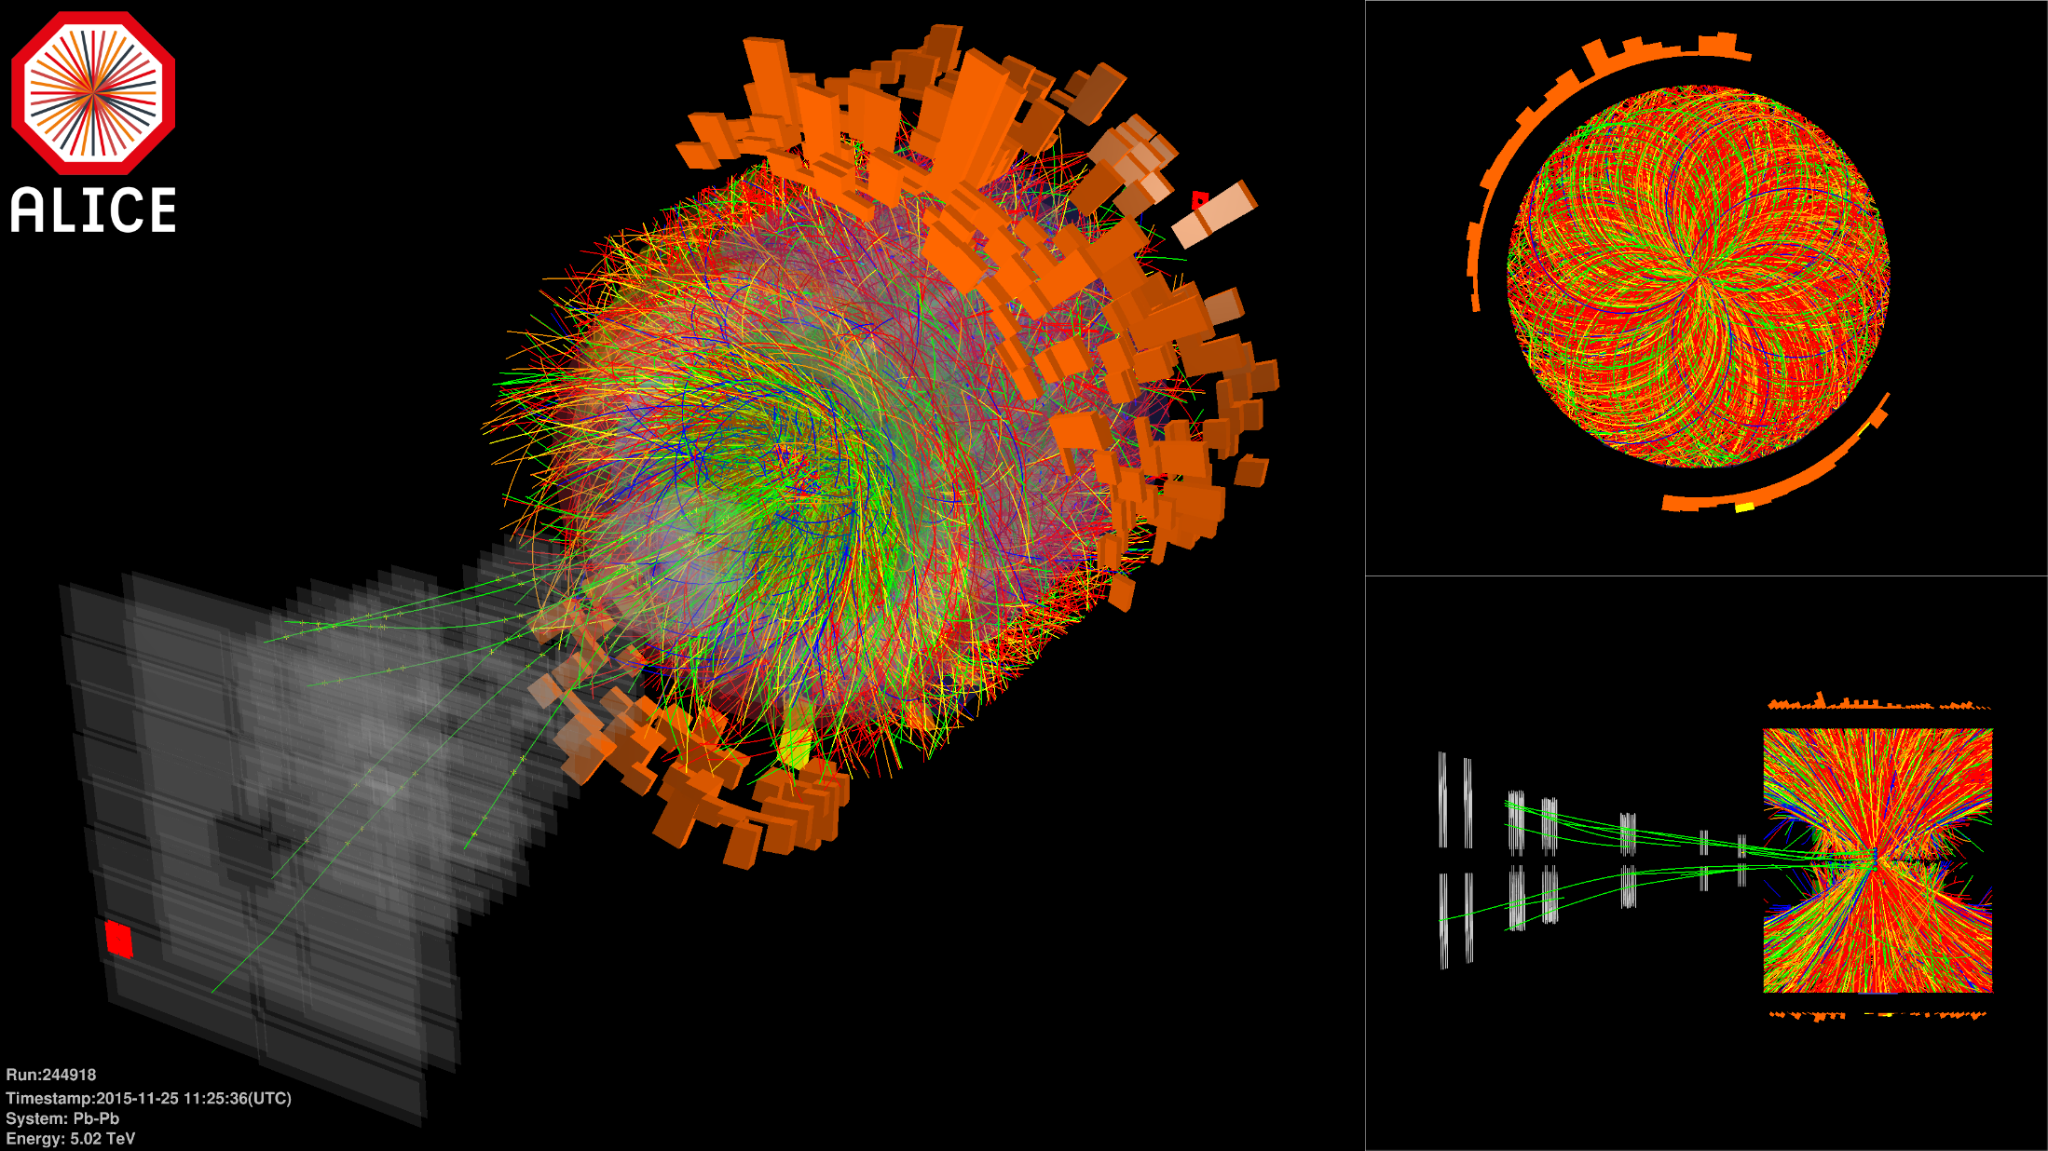
Key heavy ion physics:
Wilke van der Schee, MIT
Surprising (?): quark-gluon plasma is a fluid!
An almost ideal fluid
Experiment: billions of Pb or Au collisions
Each has ~2000(0) particles at RHIC (LHC)
Study correlations, v₂, but also v₃ etc
→very constraining data set!
Still lot of theoretical uncertainty
Initial stage (!), viscosity, jet observables

Slide 4
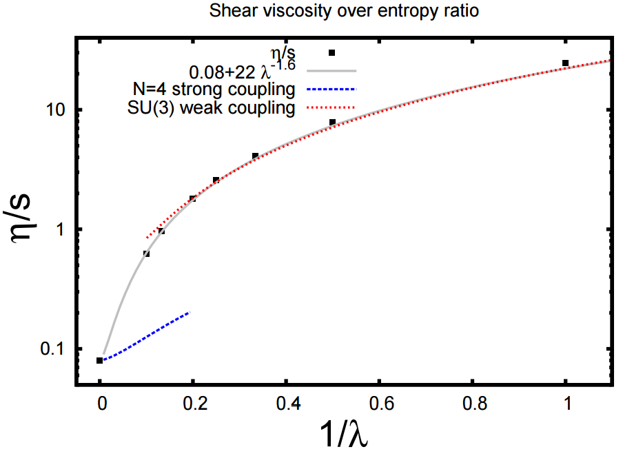
Standard model of heavy ion collisions
Wilke van der Schee, MIT/Utrecht
Initial stage goes from weak to strong coupling
Hydrodynamisation: the process of far-from-equilibrium → hydro
Rapid longitudinal expansion means much later isotropisation
Much progress on timescale: weak (kinetic) and at finite coupling
Also important: resulting temperature profile and pre-flow
L. Keegan, A. Kurkela, P. Romatschke, WS and Y. Zhu, Weak and strong coupling equilibration in nonabelian gauge theories (2015)

Slide 5
Ads/cft and holography
Wilke van der Schee, MIT
Exact equivalence between certain string theories and certain QFTs
String theory only simple in large N_{c} and infinite ’t Hooft coupling
Several examples known, but no known ‘real world’ QFT (yet?)
A typical strategy: start with `canonical’ example N =4 SYM
Theory non-confining, but confining analogues exist
Theory has 4 supersymmetries, but can be broken
Requires large N_{c}, but 1/3² seems small from lattice QCD
Infinite coupling strength (but QCD coupling runs only logarithmically…)
Holography provides a unique perspective
Only way of computing far-from-equilibrium non-perturbative dynamics
Study rich dynamics of general strongly coupled theories
Notes:
Note ihQCD: is possible to change from N=4 SYM

Slide 6
Ads/cft and holography
Wilke van der Schee, MIT
Heavy ion physics: a weak/strong coupling interplay?
A ‘hybrid’ approach: make a model inspired by strong and weak models
Bolder approach: strong coupling entirely
Qualitative/quantitative trends can inspire better modelling
In either approach some amount of fitting is required
Viscosity is good example:
Canonical theory gives benchmark value
Qualitative insight: viscosity scales as entropy
Possible to compute corrections:
Expected range: 0.08 – 0.12, link with weak coupling result?
Notes:
Note ihQCD: is possible to change from N=4 SYM

Slide 7
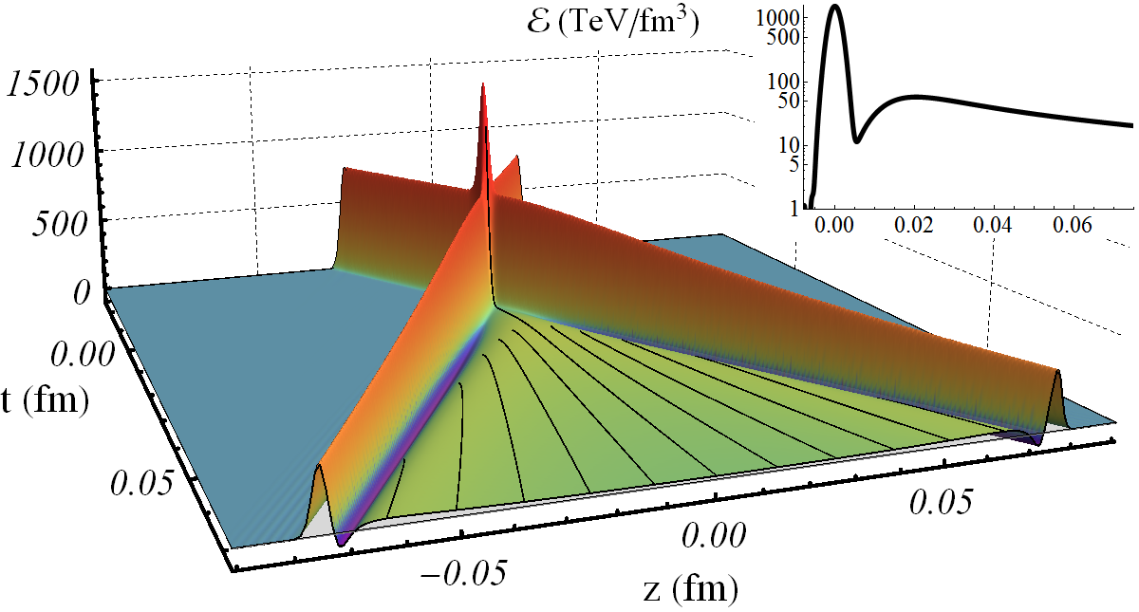
Collisions at infinitely strong coupling
Wilke van der Schee, MIT
Match longitudinal profile of energy density to nuclei
Approximately homogeneous in transverse plane
Benchmark:
J. Casalderrey-Solana, M.P. Heller, D. Mateos and WS, From full stopping to transparency in a holographic model of heavy ion collisions (2013)

Slide 8
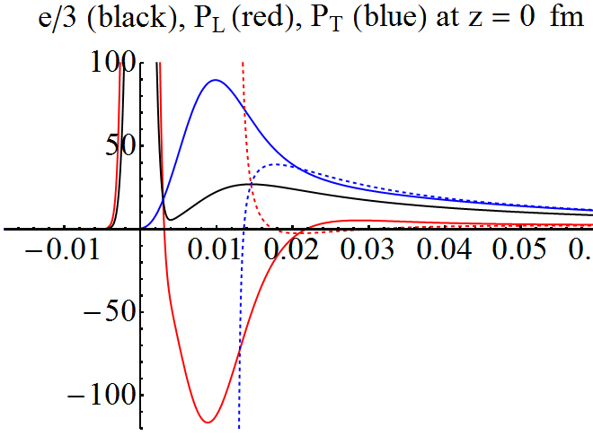
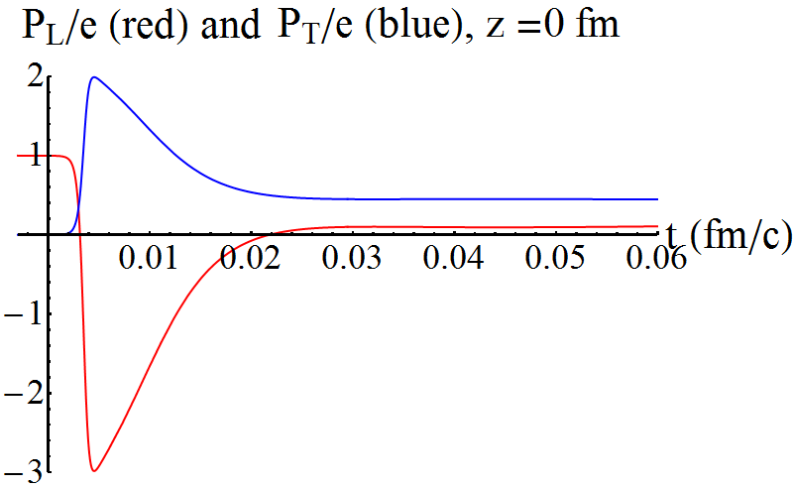
Thermalisation/pressures
Wilke van der Schee, MIT
Pressures, energy starts at zero, grows (unique to holography?)
Thermalises very fast (hydro applies in perhaps 0.02 fm/c)
Thermalisation = relaxation non-hydro modes
Gradients + viscous corrections are big
M.P. Heller, R.A. Janik and P. Witaszczyk, Hydrodynamic Gradient Expansion in Gauge Theory Plasmas (2013)

Slide 9
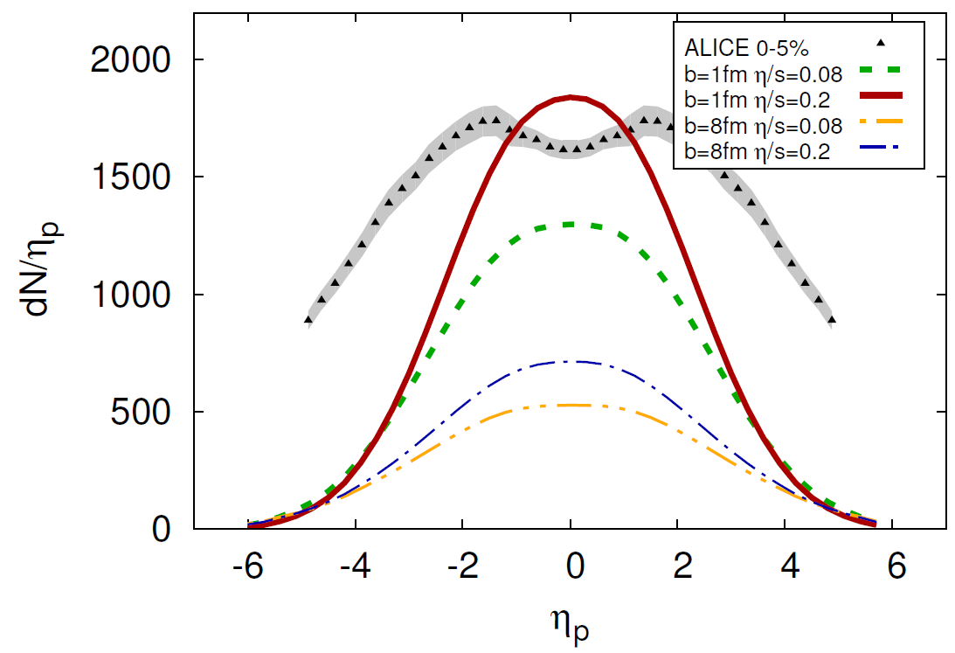
Rapidity profile + music
Wilke van der Schee, MIT
Particle spectra in longitudinal direction:
Rescaled initial energy density by factor 20
Profile is about 30% too narrow
WS and B. Schenke, Rapidity dependence in holographic heavy ion collisions (2015)
ALICE, Bulk Properties of Pb-Pb collisions at √s_{NN} = 2.76 TeV measured by ALICE (2011)

Slide 10
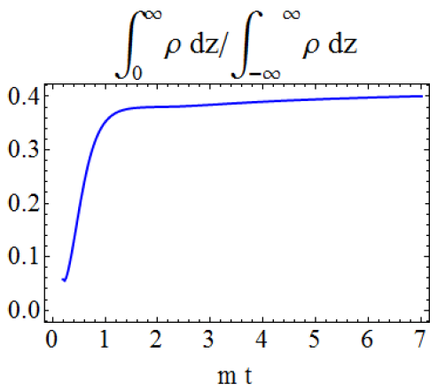
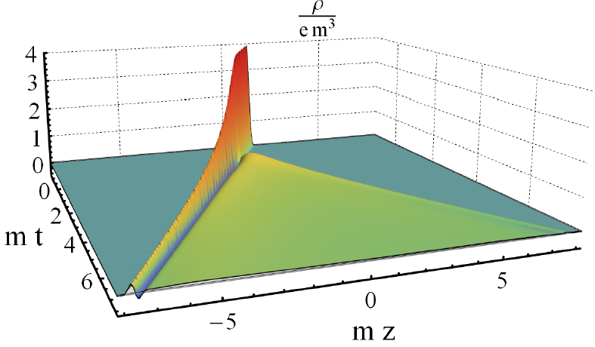
A new quantitative insight
Wilke van der Schee, MIT
Collide shocks with energy and charge
Now collide neutral with charged shock
41% of charge changes direction → strong interactions
J. Casalderrey-Solana, D. Mateos, WS and M. Triana, Holographic heavy ion collisions with baryon charge (2016)

Slide 11
Collisions at Finite coupling
Wilke van der Schee, MIT
Leading order correction: small curvature squared
Not for N=4 SYM theory (but that’s also not what we want…)
Einstein-Gauss-Bonnet theory:
Reproduces weak-coupling expectations, i.e.
Funny thing: evolution is just as simple as original ☺
Initial condition remains exact solution of EOM (for some L)
Nested scheme survives completely (with source terms)
Yevgeny Kats and Pavel Petrov, Effect of curvature squared corrections in AdS on the viscosity of the dual gauge theory (2007)
Notes:
Limit oneself to pure gravity + run on desktop (few days)

Slide 12
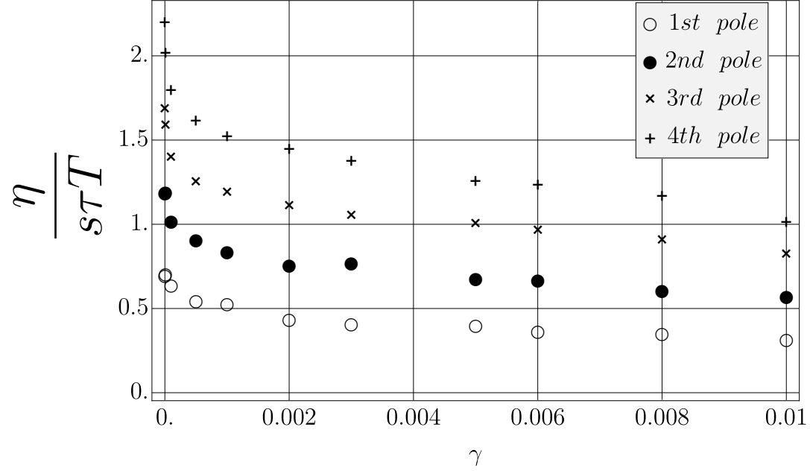
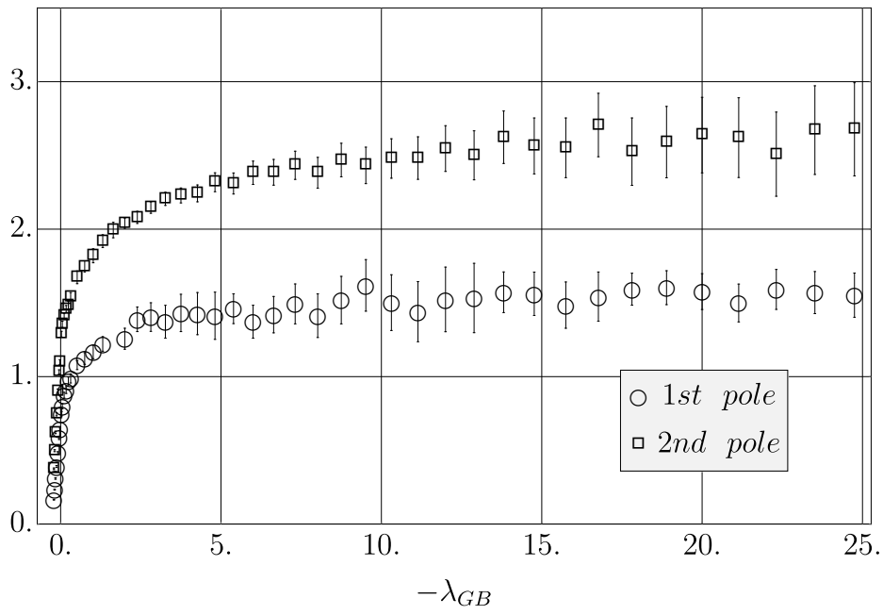
Finite coupling corrections
Wilke van der Schee, MIT/Utrecht
Beyond pure perturbative treatment:
Insightful to plot ratio viscosity and relaxation time
Ratios ~0.5 – 1.5: steep at origin (previous slides), but quickly flattens
N=4 SYM (left) and Gauss-Bonnet gravity (right):
Leading order correction (curvature squared, as opposed to R⁴)
Not N=4 SYM: Holographic dual not known explicitly (as with QCD) Seen to reproduce expectations of weaker coupling, i.e. larger viscosity
Sašo Grozdanov, Nikolaos Kaplis and Andrei Starinets, From strong to weak coupling in holographic models of thermalization (2016)
Tomas Andrade, Jorge Casalderrey-Solana and Andrej Ficnar, Holographic Isotropisation in Gauss-Bonnet Gravity (2016)
Notes:
LiMIT/Utrecht oneself to pure gravity + run on desktop (few days)

Slide 13
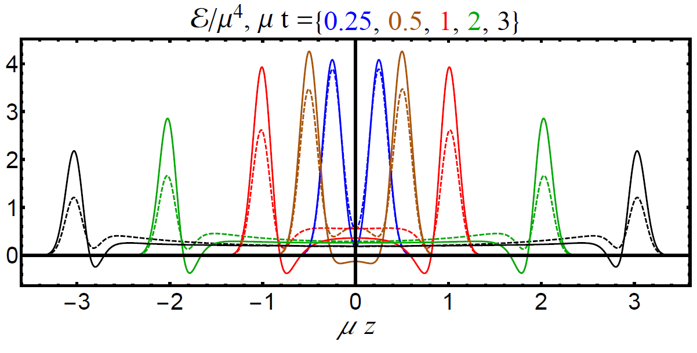
Collisions at Finite coupling - narrow
Wilke van der Schee, MIT
Results presented for, i.e (solid)
Initial condition constructed such that energy is the same
Much more energy on lightcone (more transparent, less stopping)
Energy in plasma flatter (will get to rapidity)

Slide 14
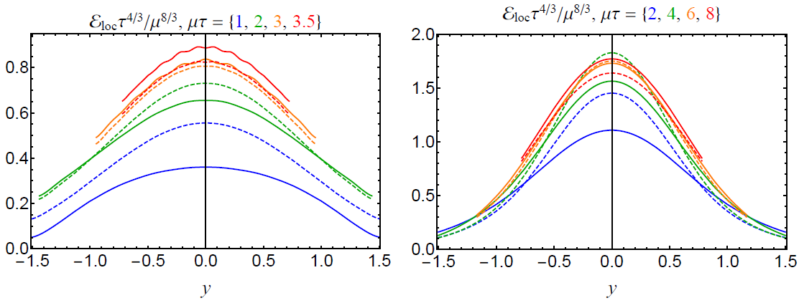
Collisions at Finite coupling - rapidity
Wilke van der Schee, MIT
Initial rapidity shape differs from Gaussian
Narrow
Wider and lower initially (energy on lightcone not shown) Later similar (time 3), then more entropy, similar width
Wide
Almost entirely by hydro + less pile-up:
First lower energies + wider
Viscosity: lower transverse pressure, more entropy

Slide 15
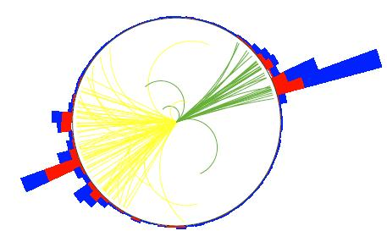
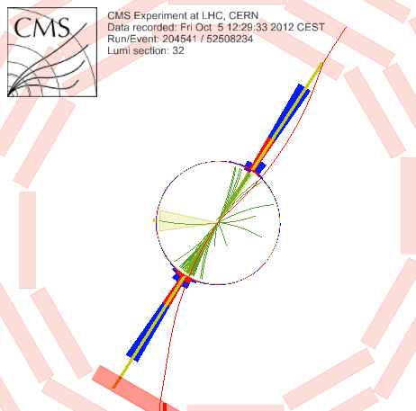
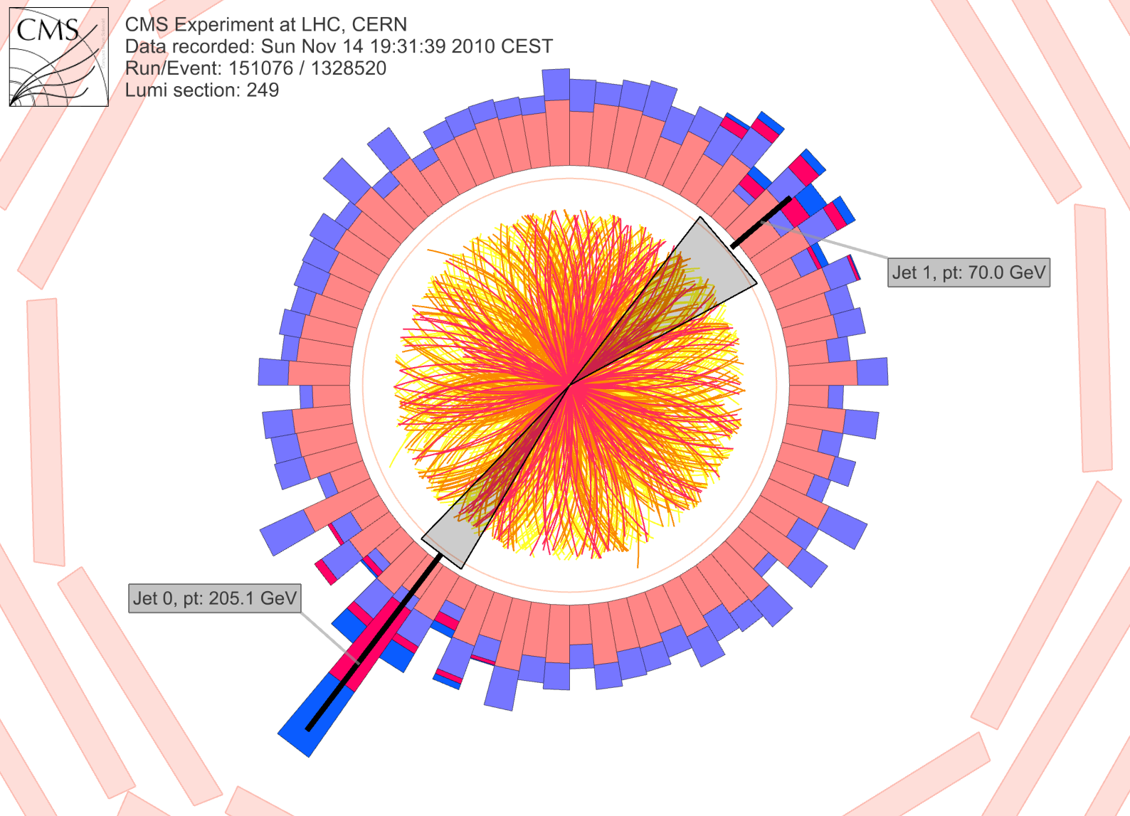
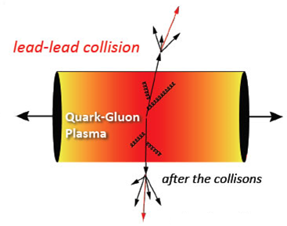
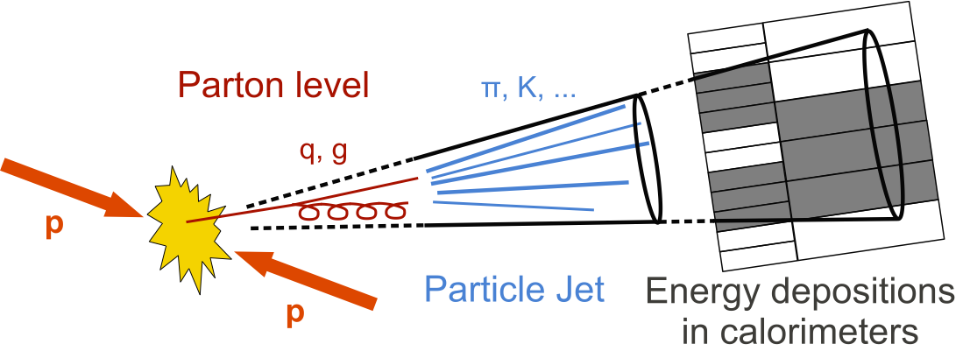
Jets in qgp
Wilke van der Schee, MIT
?
CMS PAPER EXO-12-059
Notes:
Many states + linearized

Slide 16
Olga Evdokimov, presentation Quark Matter 2015, CMS-PAS HIN-15-011

Slide 17
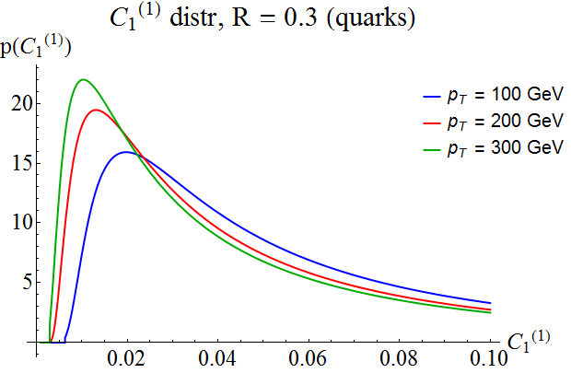
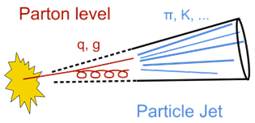
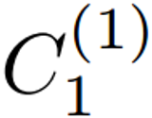
Matching both jet energy and jet width
Wilke van der Schee, MIT
Initial conditions in literature: minimize energy loss
Would like to mimic distribution of real QCD jets
Extra motivation: how is distribution affected by QGP?
Take from pQCD (compares well with PYTHIA)
Link jet width to AdS angle
z_{i}: fraction of jet energy
θ_{ij}: angle between particle i and j
R: jet radius parameter
A.J. Larkoski, S. Marzani, G. Soyez, J. Thaler, Soft drop (2014)
Notes:
Many states + linearized

Slide 18
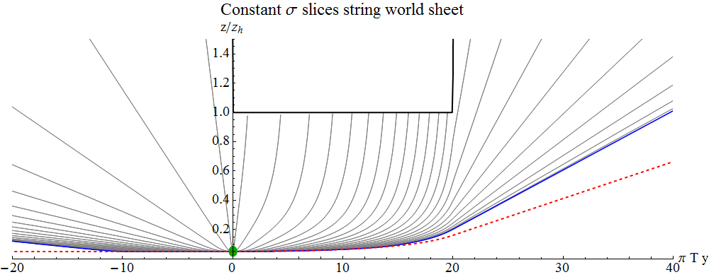
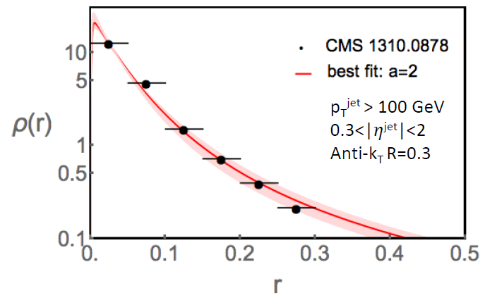
Fit vacuum jet shapes
Wilke van der Schee, MIT
Try a few string profiles to obtain angular pattern in vacuum:
Endpoint angle goes down at angle in AdS
Extract energy density per angle
Compute energy flow around jet axis
Extract jet shape
We know can construct an ensemble of strings in good agreement with vacuum QCD
Notes:
Talk about time running

Slide 19
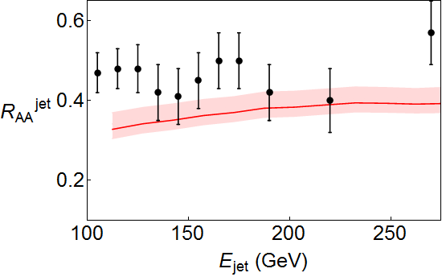
Results
Wilke van der Schee, MIT
Shooting about 50.000 jets through plasma
Used
Naïve QCD estimate gives
b: parameter multiplying temperature (simple profile in back up slide)
K. Rajagopal, A. Sadofyev and WS, Evolution of the jet opening angle distribution in holographic plasma (2016)
Notes:
Talk about time running

Slide 20
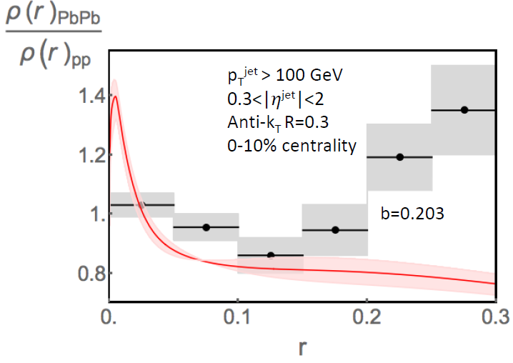
Jet shape modification
Wilke van der Schee, MIT
Shooting about 50.000 jets through plasma
Reproduces data qualitatively close to jet radius
Larger radii need inclusion of back reaction
Jasmine Brewer, Krishna Rajagopal, Andrey Sadofyev and WS, to appear
Notes:
Talk about time running

Slide 21
First effect: jets widen
Wilke van der Schee, MIT
Change of probability distributions of jet opening angle
K. Rajagopal, A. Sadofyev and WS, Evolution of the jet opening angle distribution in holographic plasma (2016)
Notes:
Many states + linearized

Slide 22
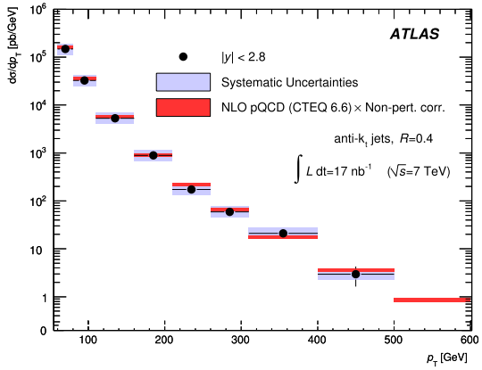
Second effect: Narrower jets
Wilke van der Schee, MIT
Energy distribution falls steeply (~E⁻⁶)
Wide jets lose (much) more energy
→ selection bias on narrow jets
ATLAS, Measurement of inclusive jet and dijet cross sections in proton-proton collisions at 7 TeV centre-of-mass energy (2011)
Notes:
Many states + linearized

Slide 23
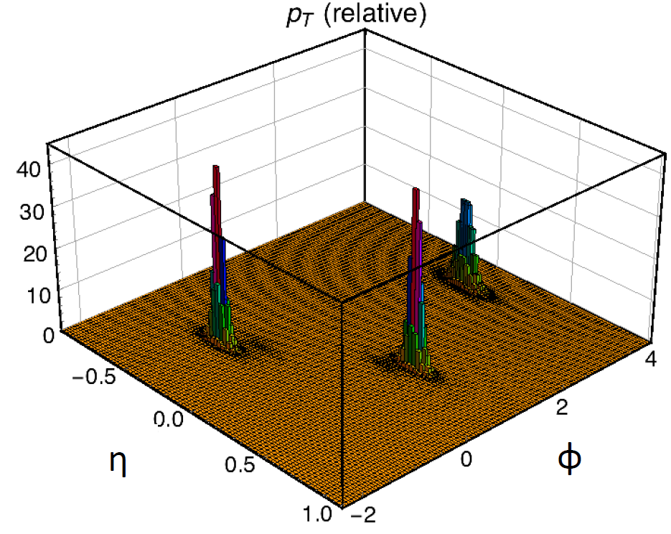
Advertisement: 3rd jets
Wilke van der Schee, MIT
Three-jet events are essential in i.e. dijet distribution
Also important as background in jet shape
Can also lead to interesting substructure within jet
Idea: get distributions from pQCD (MadGraph), make strings, etc.
ATLAS, Measurement of inclusive jet and dijet cross sections in proton-proton collisions at 7 TeV centre-of-mass energy (2011)
Notes:
Many states + linearized

Slide 24
Discussion
Wilke van der Schee, MIT
Holography and heavy ion collisions
AdS/CFT essential tool for insights in strongly coupled matter
Complementary with weak coupling modelling
Qualitative lessons and quantitative modelling
Fast applicability of hydrodynamics
Most of energy stopped at moderate rapidity, Gaussian shape
Less stopping and broader rapidity profile at finite coupling
Energy loss jet has crucial interplay with jet width
Hydro in small systems feasible at strong coupling (left out)
Outlook
More quantitative comparisons with experiment, perhaps fitting width rapidity spectrum etc
Improved models closer to QCD, include running coupling
Notes:
Many states + linearized

Slide 25
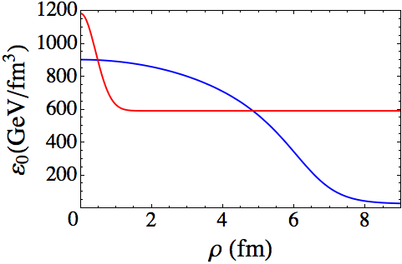
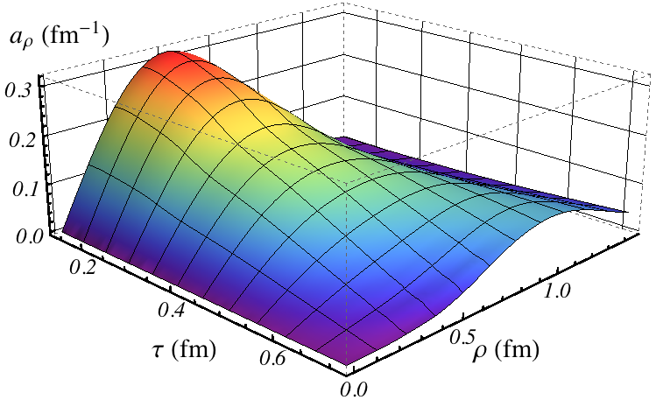
Two computations for small systems
Wilke van der Schee, MIT
A fluctuation in a thermal bath:
Hydro works within 0.2 fm/c, for system of size 0.5 fm.
A full-blown off-center `p-p collision’:
Hydro found to work in a system with R ~ 1/T
WS, Holographic thermalization with radial flow (2012)
Paul Chesler, How big are the smallest drops of quark-gluon plasma? (2016)

Slide 26
An estimate
Wilke van der Schee, MIT
For p-Pb and p-p collisions only few particles produced
Naïve estimate: gives
Volume per rapidity: R²τ_{ini}
When R > 1/T (and τ_{ini}T>1) then dN_{ch}/dy > 4
Note that R increases faster than 1/T (τ versus τ^{1/3})
Hydro works better at later times
Flow requires time to develop, i.e. 4 is `optimistic’ estimate

Slide 27
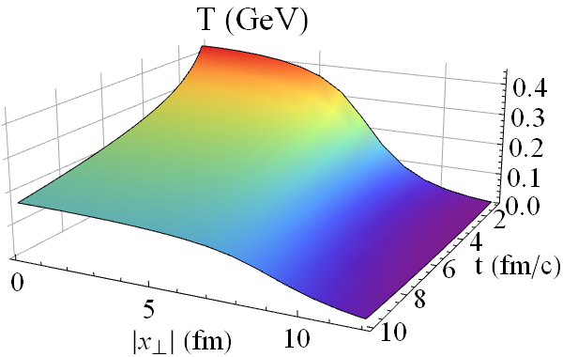
More simplifications
Wilke van der Schee, MIT
Simple semi-analytic hydrodynamic temperature profile:
Neglect initial dynamics (1 fm/c) + hadronization + confinement
Start string at single point at boundary
Distribute according to binary scaling and
Free parameter b: to get reasonably energy loss ((coupling) )
(b measures N_{ch} per S, given EOS)
A. Ficnar, S.S. Gubser and M. Gyulassy, Shooting String Holography of Jet Quenching at RHIC and LHC (2013)
Notes:
Many states + linearized

