Slide 1
Finite endpoint momentum strings & Applications to energy loss
Andrej Ficnar, Steven S. Gubser and Miklos Gyulassy
Based on:
Andrej Ficnar Columbia University
arXiv:1306.6648 [hep-th]
arXiv:1311.6160 [hep-ph]

Slide 2
Outline
Finite momentum at string endpoints
Introduction & motivation
Introducing the finite momentum
Superstring construction
Applications to energy loss
AdS/CFT and light quarks
How far can you shoot a string?
Energy loss in QGP
Conclusions
Finite endpoint momentum strings & applications to energy loss | Andrej Ficnar
1/26

Slide 3
❶ Introduction & motivation

Slide 4
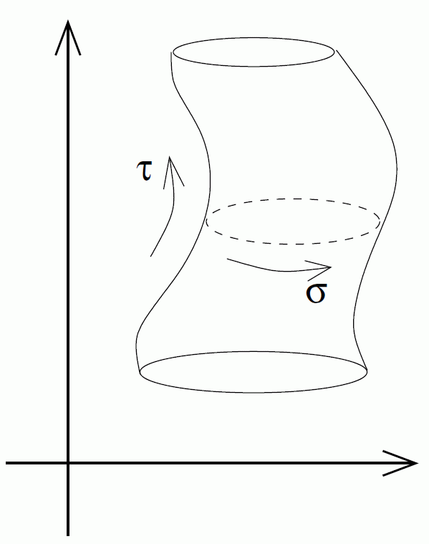
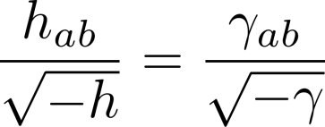
Classical relativistic strings
Described by the Polyakov action
Define:
Equations of motion:
worldsheet currents
induced worldsheet metric
Finite endpoint momentum strings & applications to energy loss | Andrej Ficnar
2/26

Slide 5
Classical relativistic strings
Boundary term:
Endpoint motion:
Lightlike trajectories
Always transverse to the string
This together with in general implies no endpoint momentum
open strings
at endpoints
free endpoints
Finite endpoint momentum strings & applications to energy loss | Andrej Ficnar
3/26

Slide 6
A flat space example
Bosonic string in in conformal gauge
Define a lightlike trajectory:
A solution to bulk EOMs:
Endpoints at obey the usual boundary conditions
Finite endpoint momentum strings & applications to energy loss | Andrej Ficnar
4/26

Slide 7
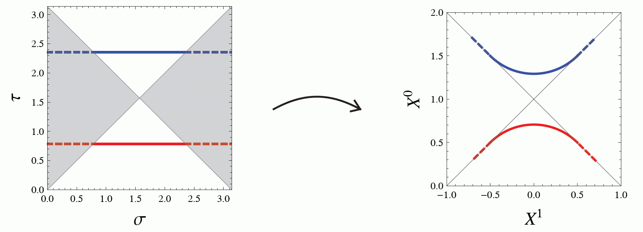
A flat space example
Take the “yo-yo” limit:
In static gauge ( ) this is not even possible unless we allow for finite endpoint momentum (FEM):
Account of the yo-yo-type trajectories in gauges where WS mapping is non-degenerate and one-to-one
non-conformal mapping:
standard b.c. still hold
Finite endpoint momentum strings & applications to energy loss | Andrej Ficnar
5/26

Slide 8
❷ Introducing the finite momentum

Slide 9
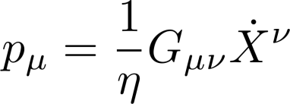
Introducing the finite momentum
Add a boundary term to the action
An explicit introduction of a specific boundary term ⇨ only a selection of a class of possible solutions of the bulk string action
Boundary parametrized by and
Equation of motion for the einbein :
Define the endpoint momentum:
Boundary equations of motion:
Ficnar & Gubser, 2013
endpoints are lightlike in spacetime
also on worldsheet
“ ”
2nd order b.c.?
Finite endpoint momentum strings & applications to energy loss | Andrej Ficnar
6/26

Slide 10
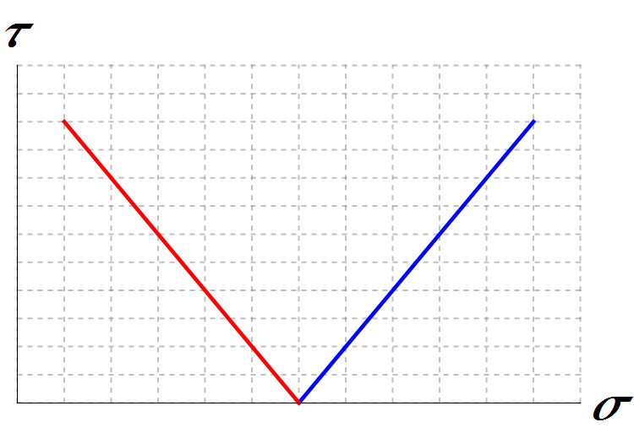
Endpoints move on null geodesics
The key is the identity
Boundary EOM then becomes:
This is really a geodesic equation:
Kinematically: endpoints always move along null geodesics Dynamically: their momenta increase/decrease
independent of the string
Finite endpoint momentum strings & applications to energy loss | Andrej Ficnar
7/26

Slide 11
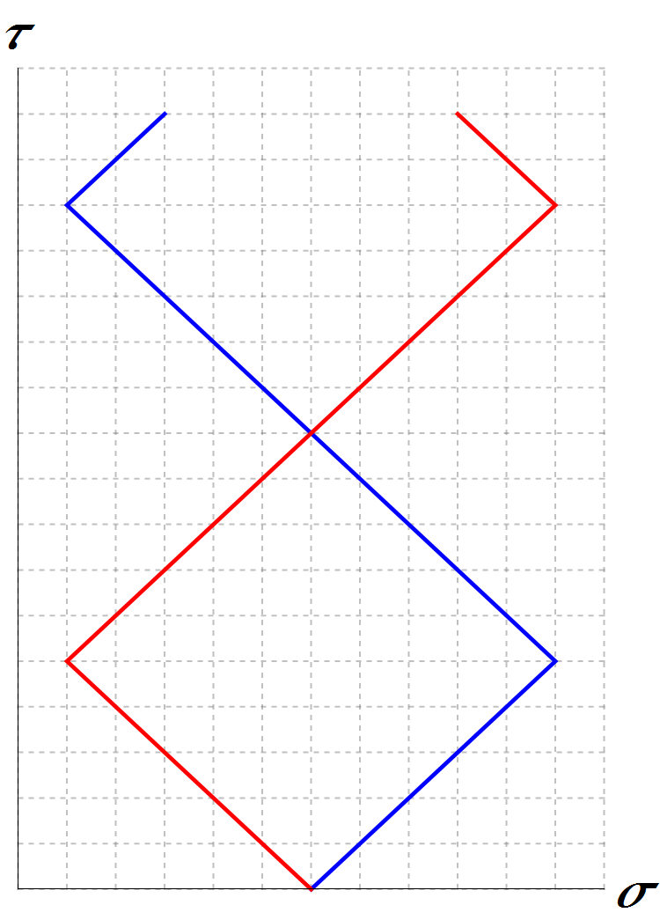
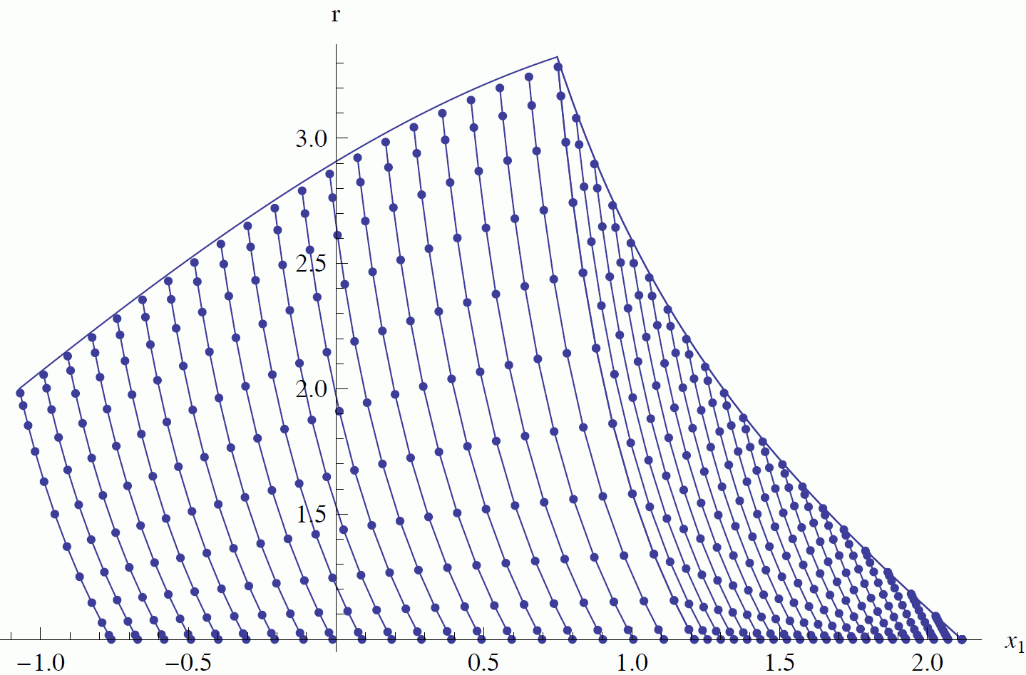
Snap-backs
What happens when ?
Prescribe: endpoint change directions:
Can be done by demanding be continuous before & after snap-back
Shape of the string determines the new geodesic
Examples:
Flat (1+1)D: Lund model
In general not so simple, e.g. in
Finite endpoint momentum strings & applications to energy loss | Andrej Ficnar
8/26

Slide 12
❸ Superstring construction

Slide 13
GS action in light-cone gauge
Green-Schwarz superstring action in light-cone gauge in flat space
Generalization to FEM such that all super-Q’s are preserved
Light-cone gauge in the bulk of the string
GS action for the string (bulk)
SUSY variations
Green & Schwarz, 1982-84
Majorana-Weyl spinor in 10D and 2D
Finite endpoint momentum strings & applications to energy loss | Andrej Ficnar
9/26

Slide 14
Augment the boundary action
Concentrate on the boundary and choose
Here we used the standard b.c. (and )
Augment the boundary action with:
Because then:
What about -symmetry? Curved spaces?
Finite endpoint momentum strings & applications to energy loss | Andrej Ficnar
10/26

Slide 15
❹ AdS/CFT and light quarks

Slide 16
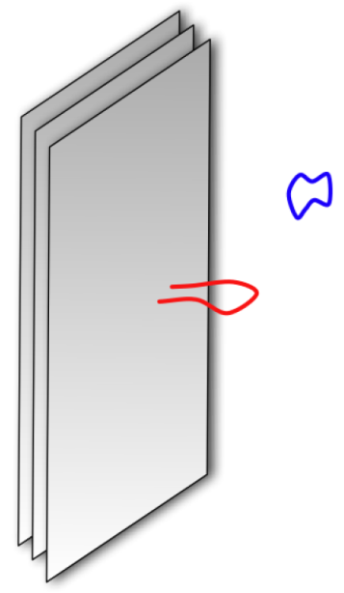
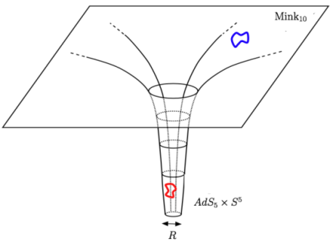
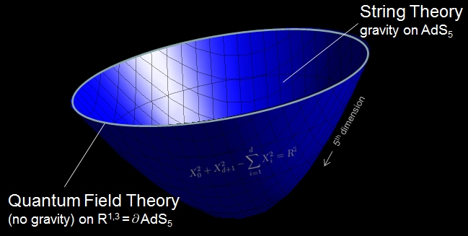
AdS/CFT in a nutshell
Stack of coincident D3 branes in type IIB string theory
Take the ‘t Hooft limit:
one can study strongly coupled gauge theories by doing classical, two-derivative (super)gravity calculations
Low energy effective action: (3+1)-dim SYM
Maldacena, 1998
Throat region of the metric sourced by the branes:
Finite endpoint momentum strings & applications to energy loss | Andrej Ficnar
11/26

Slide 17
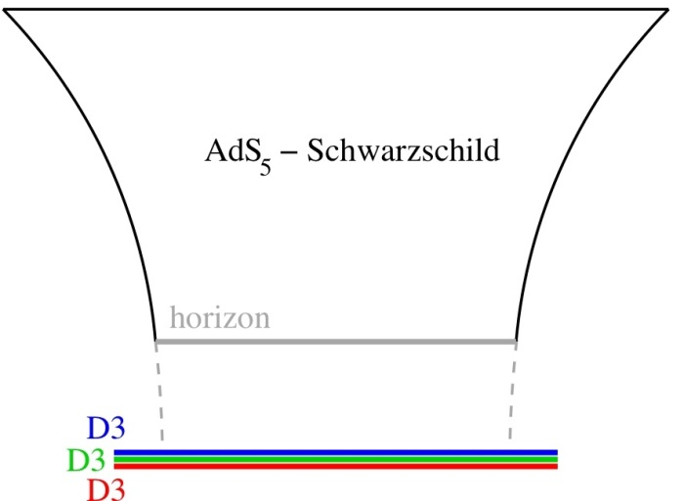
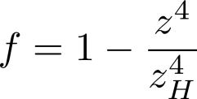
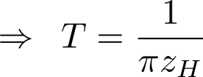
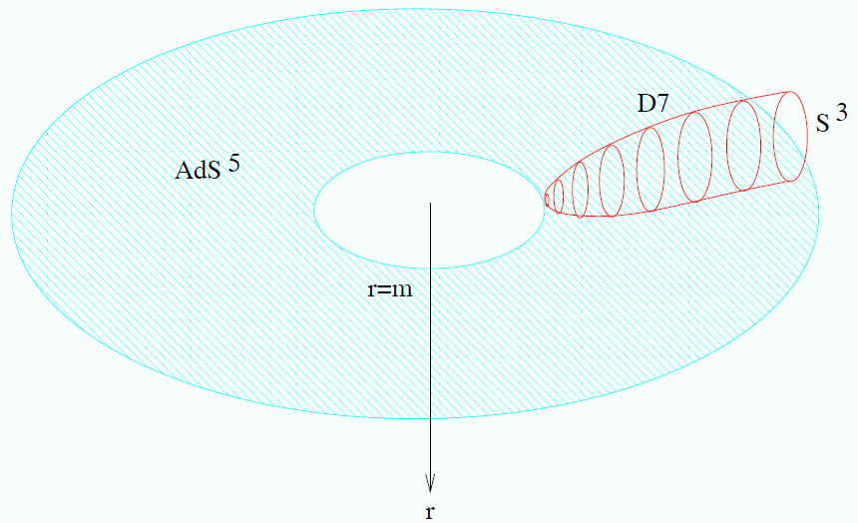
Finite temperatures and quarks
Finite temperatures  black brane
Fundamental d.o.f.’s  D7 branes
boundary
Karch & Katz, 2002
Introduces hypermultiplet with mass
Light ‘quarks’:
Finite endpoint momentum strings & applications to energy loss | Andrej Ficnar
12/26

Slide 18
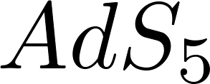
Light quarks as falling strings
(boundary)
Finite endpoint momentum strings & applications to energy loss | Andrej Ficnar
13/26

Slide 19
Light quarks as falling strings
(boundary)
Finite temperatures:
black hole
Finite endpoint momentum strings & applications to energy loss | Andrej Ficnar
13/26

Slide 20
Light quarks as falling strings
(boundary)
D7-brane
Introduce ‘quarks’:
Karch & Katz, 2002
black hole
Finite endpoint momentum strings & applications to energy loss | Andrej Ficnar
13/26

Slide 21
Light quarks as falling strings
(boundary)
D7-brane
Light ‘quarks’:
black hole
Finite endpoint momentum strings & applications to energy loss | Andrej Ficnar
13/26

Slide 22
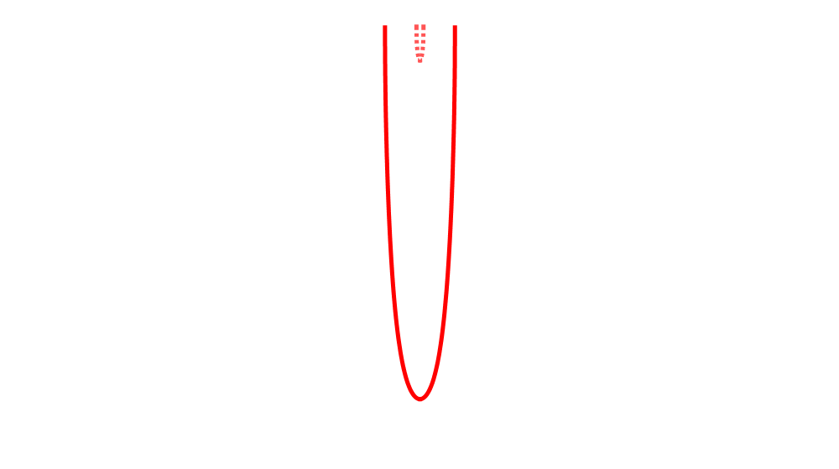
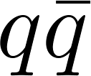
Light quarks as falling strings
(no FEM)
Open strings on a D7 brane = dressed pairs
Chesler et al., 2009
Finite endpoint momentum strings & applications to energy loss | Andrej Ficnar
13/26

Slide 23
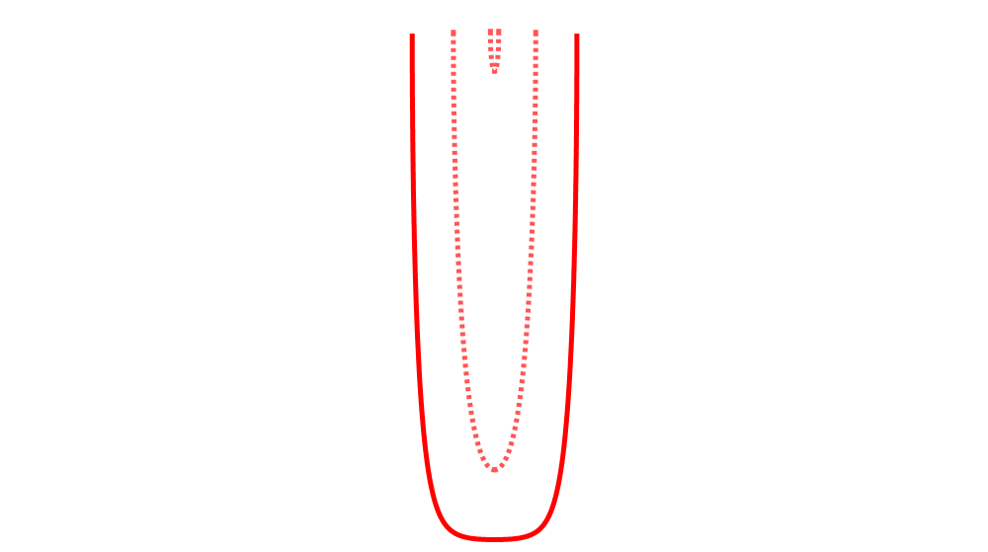
Light quarks as falling strings
(no FEM)
Open strings on a D7 brane = dressed pairs
Chesler et al., 2009
Finite endpoint momentum strings & applications to energy loss | Andrej Ficnar
13/26

Slide 24
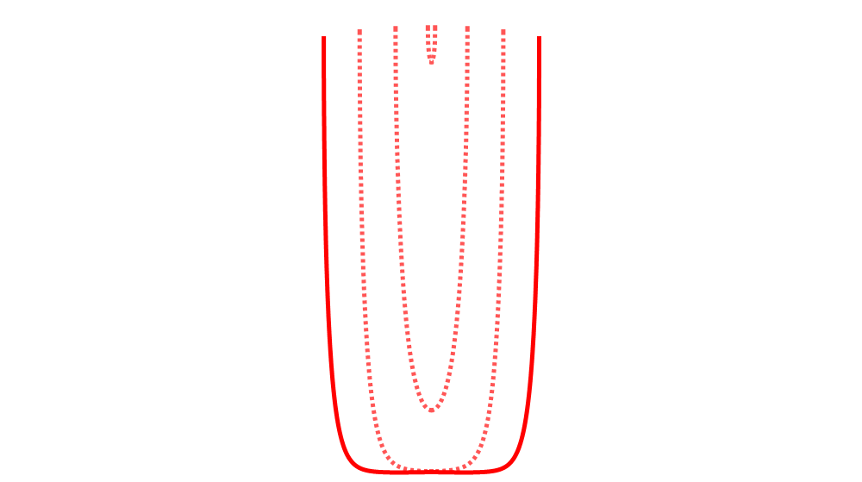
Light quarks as falling strings
(no FEM)
Open strings on a D7 brane = dressed pairs
Chesler et al., 2009
Finite endpoint momentum strings & applications to energy loss | Andrej Ficnar
13/26

Slide 25
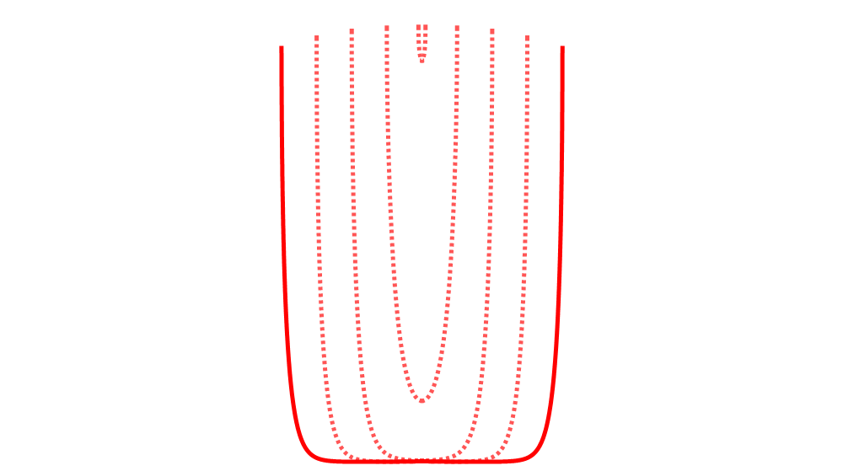
Light quarks as falling strings
(no FEM)
Open strings on a D7 brane = dressed pairs
Chesler et al., 2009
Finite endpoint momentum strings & applications to energy loss | Andrej Ficnar
13/26

Slide 26
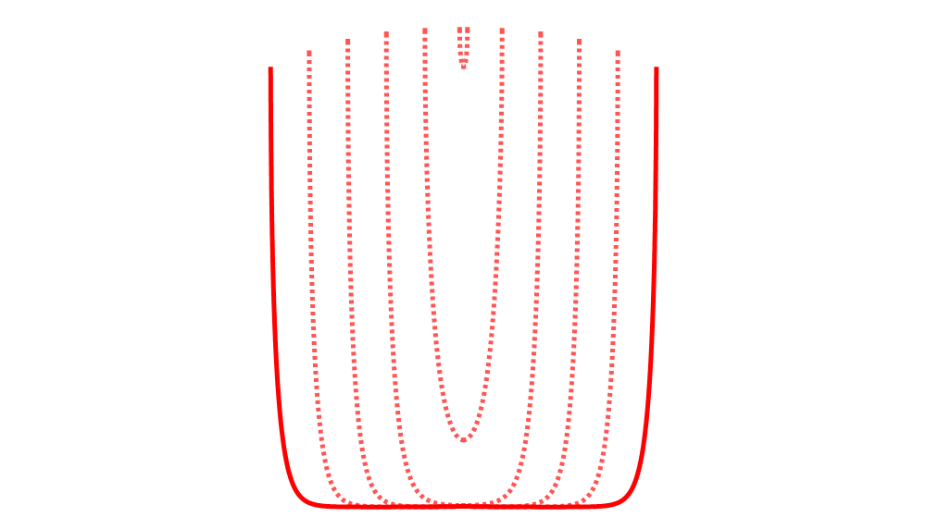
Light quarks as falling strings
(no FEM)
Open strings on a D7 brane = dressed pairs
Chesler et al., 2009
Finite endpoint momentum strings & applications to energy loss | Andrej Ficnar
13/26

Slide 27
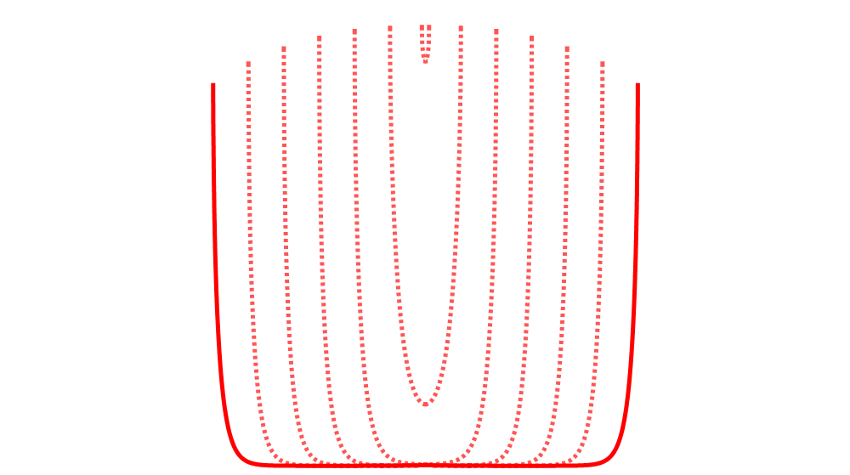
Light quarks as falling strings
(no FEM)
Open strings on a D7 brane = dressed pairs
Chesler et al., 2009
Falling strings
Finite endpoint momentum strings & applications to energy loss | Andrej Ficnar
13/26

Slide 28
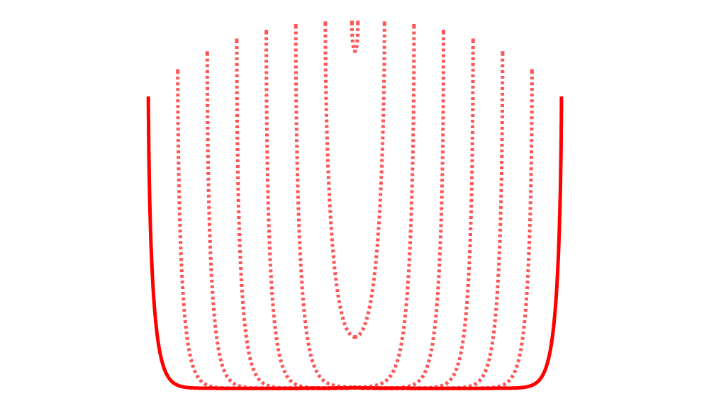
Light quarks as falling strings
(no FEM)
Open strings on a D7 brane = dressed pairs
Chesler et al., 2009
Falling strings
Finite endpoint momentum strings & applications to energy loss | Andrej Ficnar
13/26

Slide 29
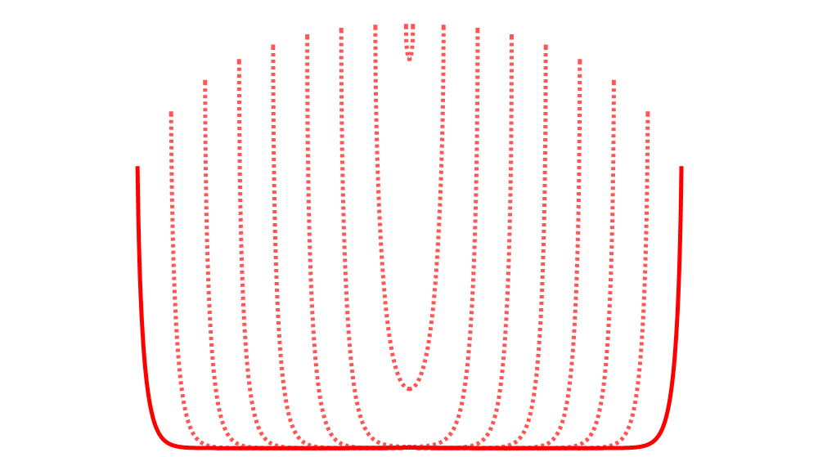
Light quarks as falling strings
(no FEM)
Open strings on a D7 brane = dressed pairs
Chesler et al., 2009
Falling strings
Finite endpoint momentum strings & applications to energy loss | Andrej Ficnar
13/26

Slide 30
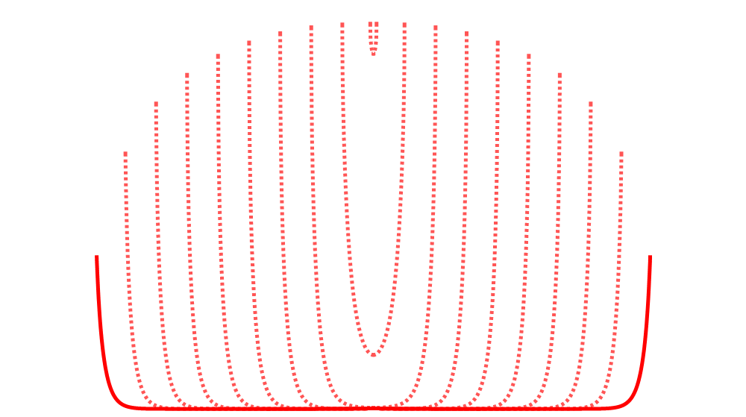
Light quarks as falling strings
(no FEM)
Open strings on a D7 brane = dressed pairs
Chesler et al., 2009
Falling strings
Finite endpoint momentum strings & applications to energy loss | Andrej Ficnar
13/26

Slide 31
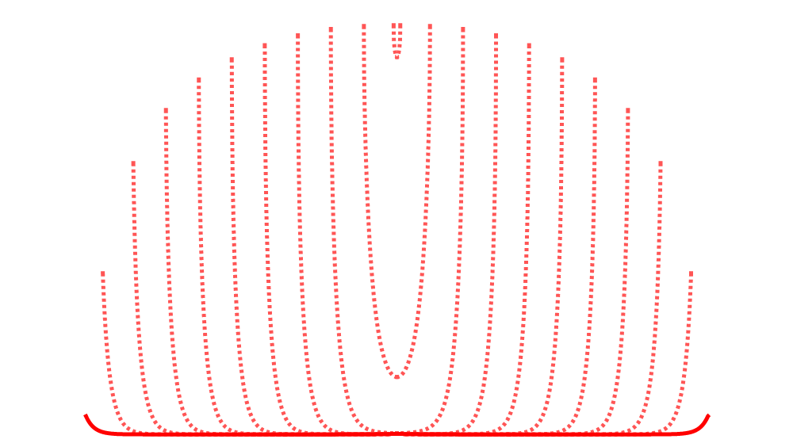
Light quarks as falling strings
(no FEM)
Open strings on a D7 brane = dressed pairs
Chesler et al., 2009
Falling strings
Finite endpoint momentum strings & applications to energy loss | Andrej Ficnar
13/26

Slide 32
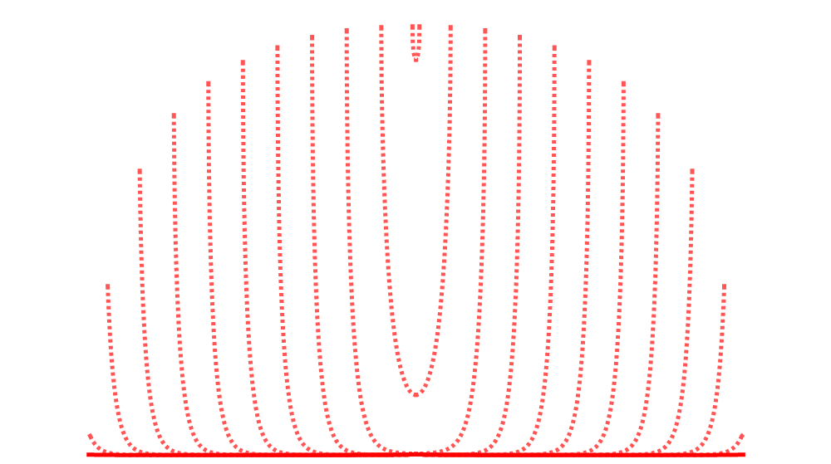
Light quarks as falling strings
(no FEM)
Open strings on a D7 brane = dressed pairs
Chesler et al., 2009
Falling strings
stopping distance Δx
Finite endpoint momentum strings & applications to energy loss | Andrej Ficnar
13/26

Slide 33
❺ How far can you shoot a string?

Slide 34
Maximum stopping distance
For falling strings (no FEM) in the high energy limit:
Endpoints approximately follow null geodesics
Universal UV part of the energy of the string
Chesler et al., 2009
Gubser et al., 2008
Chesler et al., 2009
(numerically)
Ficnar & Gubser, 2013
(analytically)
Finite endpoint momentum strings & applications to energy loss | Andrej Ficnar
14/26

Slide 35
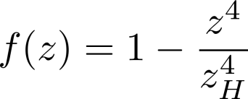
FEM falling strings
For FEM strings, most of energy in the endpoint is optimal
More realistic description of energetic quarks
Assume no snap-back
Initially, at we have
Finally, at we have
In high energy limit ( )
Finite endpoint momentum strings & applications to energy loss | Andrej Ficnar
15/26

Slide 36
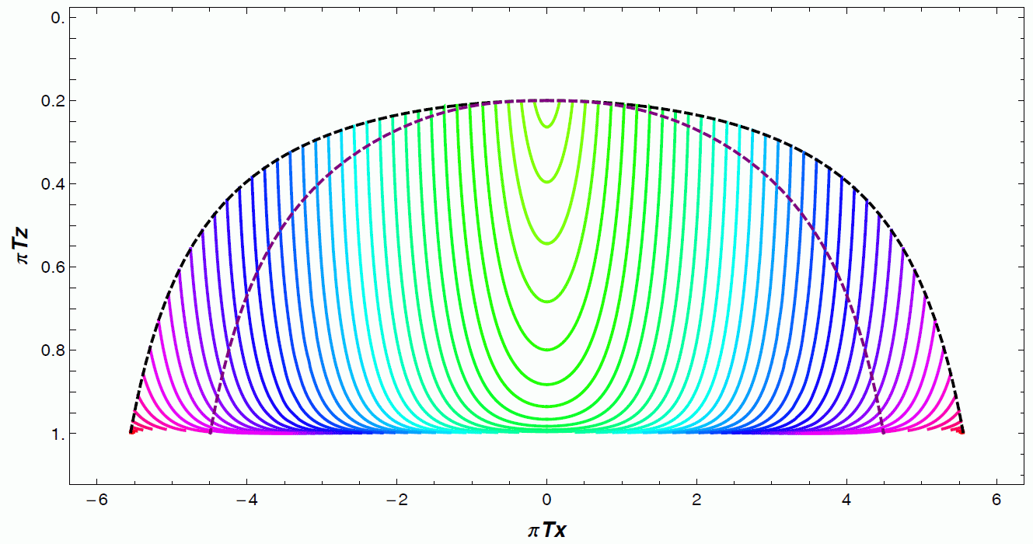
FEM falling strings - numerics
Choose “stretching gauge”
Pointlike initial conditions
Null geodesics as explicit b.c.
Finite endpoint momentum strings & applications to energy loss | Andrej Ficnar
16/26

Slide 37
FEM shooting strings
Allow for a part of the string to be behind horizon, only care about maximizing
Finite endpoint momentum strings & applications to energy loss | Andrej Ficnar
17/26

Slide 38
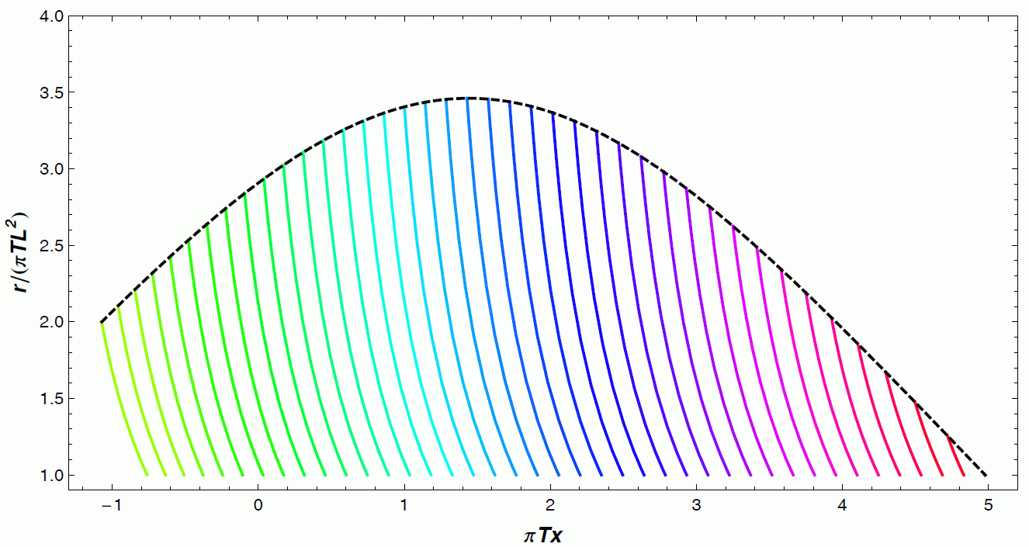
FEM shooting strings - numerics
Eddington-Finkelstein coordinates
Pseudospectral methods
Collocation points on a scaled Gauss-Lobatto grid
Finite endpoint momentum strings & applications to energy loss | Andrej Ficnar
18/26

Slide 39
❻ Energy loss in QGP

Slide 40
Instantaneous energy loss
Interesting quantity and important for holographic calculations of HIC observables at RHIC and LHC: and
QGP produced in HIC is strongly-coupled
Medium properties encoded in the metric
Energy loss from falling strings
Need energy loss formalism for non-stationary strings
Susceptible to initial conditions and depends on the “jet” definition
Modified Bragg peak and approximately
Gives the right shape of but a very low magnitude ⇨ jet quenching too strong
Gyulassy & McLerran, 2005
Kiritsis et al., 2008
Gubser et al., 2008
Ficnar, 2012
Ficnar, Noronha & Gyulassy, 2012
Finite endpoint momentum strings & applications to energy loss | Andrej Ficnar
19/26

Slide 41
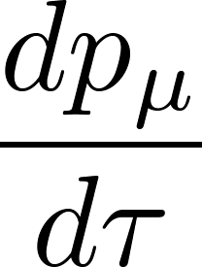
FEM strings as (energetic) light quarks
A more realistic description of an energetic quark:
Endpoint  quark
String  color field
Clear definition of the energy loss: energy drained from the endpoint into the bulk of the string
Finite endpoint momentum strings & applications to energy loss | Andrej Ficnar
20/26

Slide 42
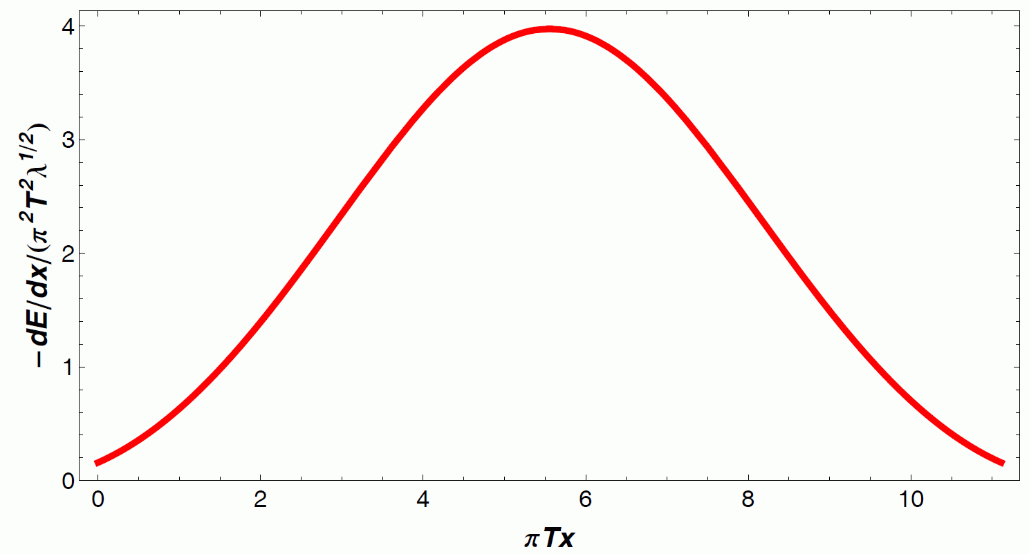
Energy loss from FEM strings
A universal form of the energy loss:
Local quantity, independent of initial conditions & bulk shape of string
Independent of energy stored in the endpoint
Solve for null geodesics:
Finite endpoint momentum strings & applications to energy loss | Andrej Ficnar
21/26

Slide 43
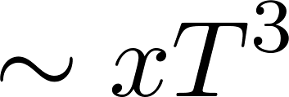
Shooting string limit
Ficnar, Gubser & Gyulassy, 2013
Assuming :
for small
like pQCD collisional e-loss
for intermediate
like pQCD radiative e-loss (only path dep.)
for large
old “AdS” e-loss
e.g.
Marquet & Renk, 2010
Finite endpoint momentum strings & applications to energy loss | Andrej Ficnar
22/26

Slide 44
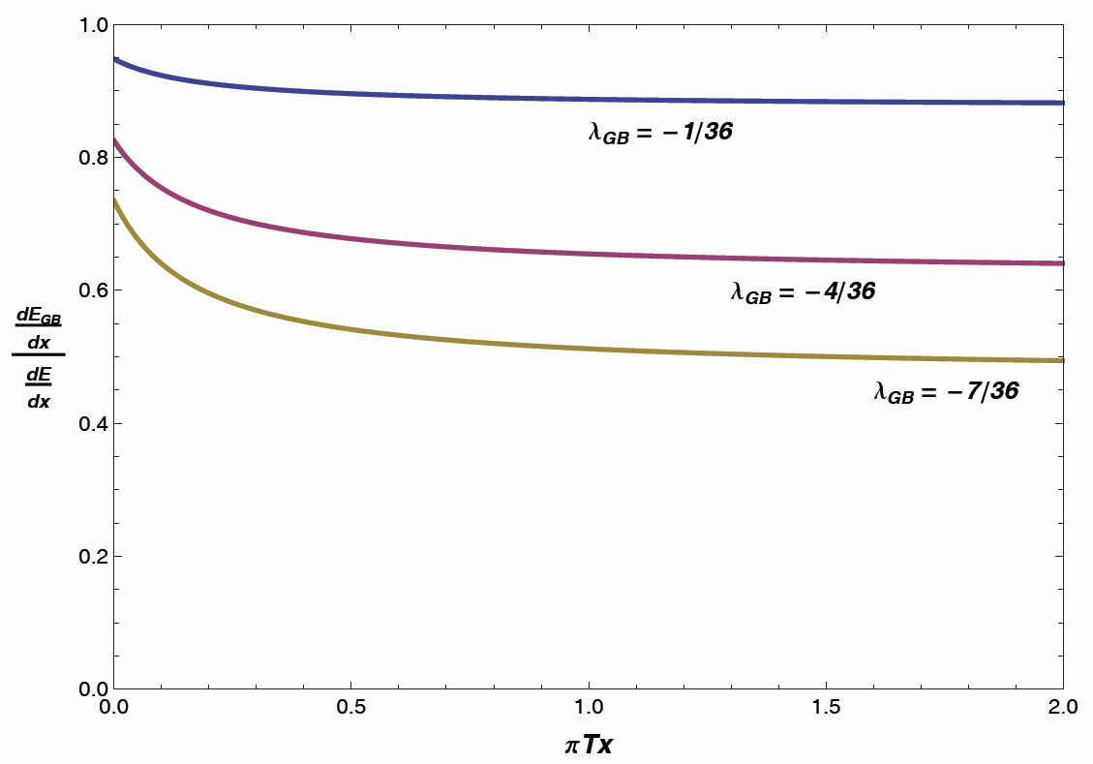
Higher derivative corrections
Inspect the effect of generic higher derivative corrections: -terms, model with Gauss-Bonnet term
Causality & energy positivity:
Black hole solution:
Shear viscosity:
Hofman & Maldacena, 2008
Cai, 2002
Myers et al., 2008
Myers et al., 2008
decreases energy loss?
Finite endpoint momentum strings & applications to energy loss | Andrej Ficnar
23/26

Slide 45
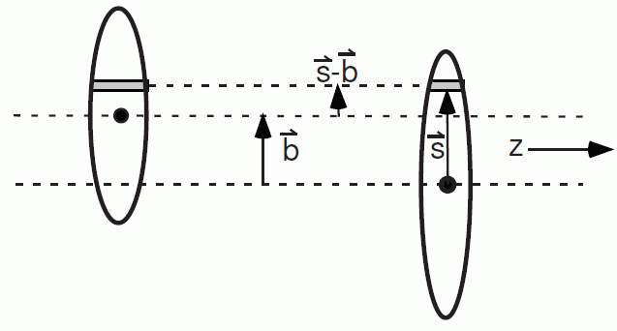
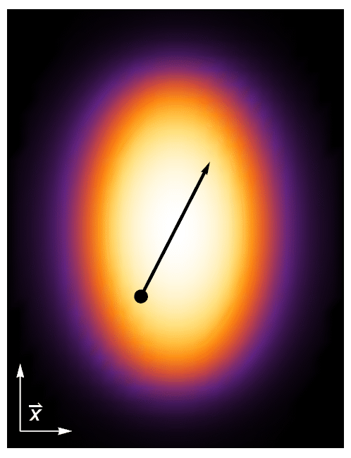
Modeling a realistic QGP
Model a heavy ion collision using Glauber model
Nuclear modification factor
Finite endpoint momentum strings & applications to energy loss | Andrej Ficnar
24/26

Slide 46
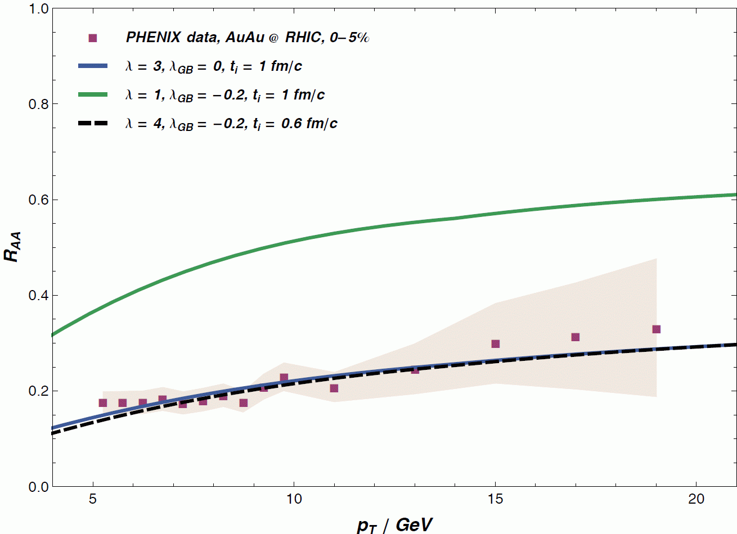
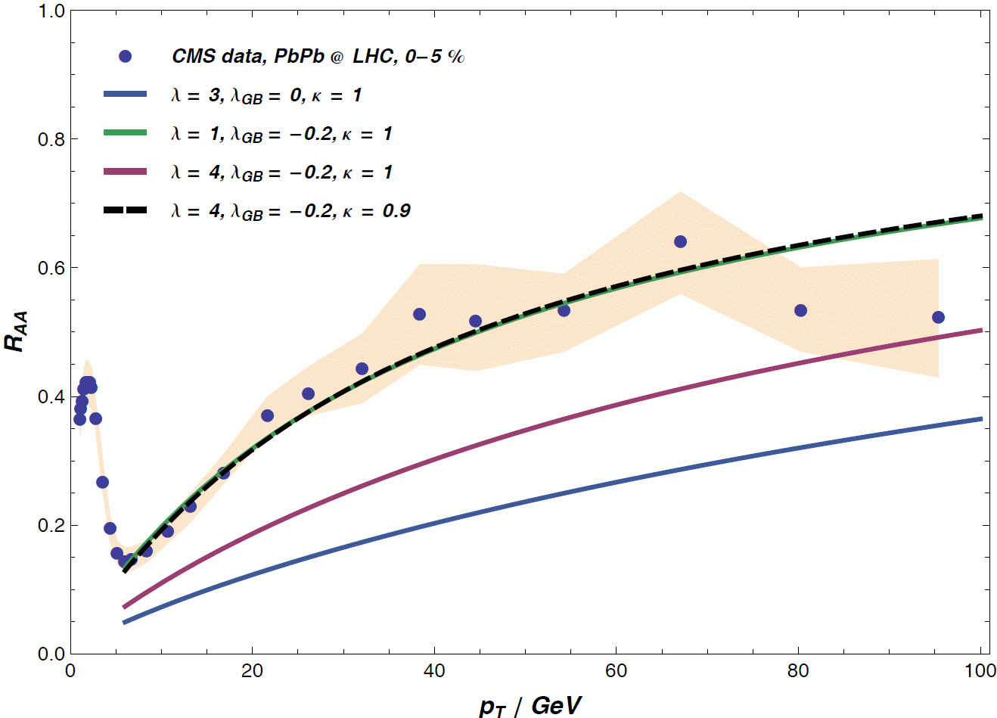
Summary of the results
+ more details in our
1311.6160 [hep-ph]
Finite endpoint momentum strings & applications to energy loss | Andrej Ficnar
25/26

Slide 47
❼ Conclusions

Slide 48
Conclusions
Classical strings, both bosonic and supersymmetric, can have finite momentum at their endpoints
Endpoints move along null geodesics
Independent of strings, except during snap-backs
FEM strings offer better holographic picture of energy loss:
More realistic description of an energetic quark
Larger stopping distances
Clear definition of energy loss
Local quantity, independent of string initial conditions
Encodes interesting physics (path dependence)
Good match with the RHIC and LHC light hadron suppression data
Prospects: heavy quarks, finite corrections, …
Finite endpoint momentum strings & applications to energy loss | Andrej Ficnar
26/26

Slide 49
Backup & extra slides

Slide 50
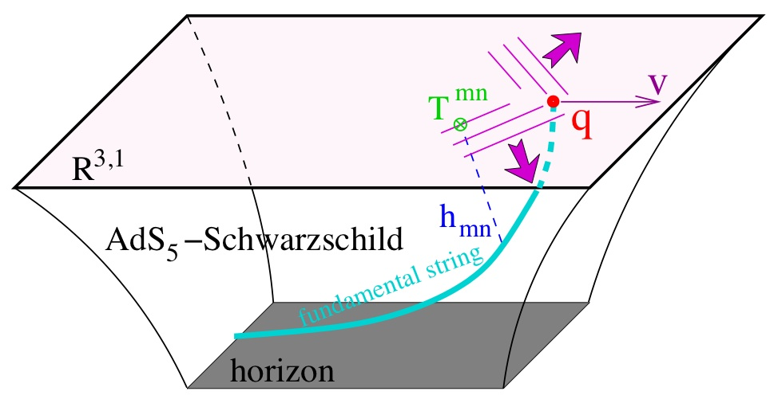
Jets in AdS/CFT - cartoon
Finite endpoint momentum strings & applications to energy loss | Andrej Ficnar

Slide 51
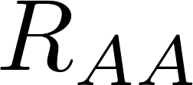
A realistic R_{AA}
Imitate QCD:
Introduce GeV’s and fm’s
Account for 3x more d.o.f.’s in than in QCD:
Promote a constant
Transverse expansion via blast wave:
KKP fragmentation functions
computation in a nutshell
Jet created at some moving in the direction
Find where
For a given find its initial
Then
Gubser, 2007
Betz & Gyulassy, 2013
Shooting strings at RHIC and LHC | Andrej Ficnar
16/22

Slide 52
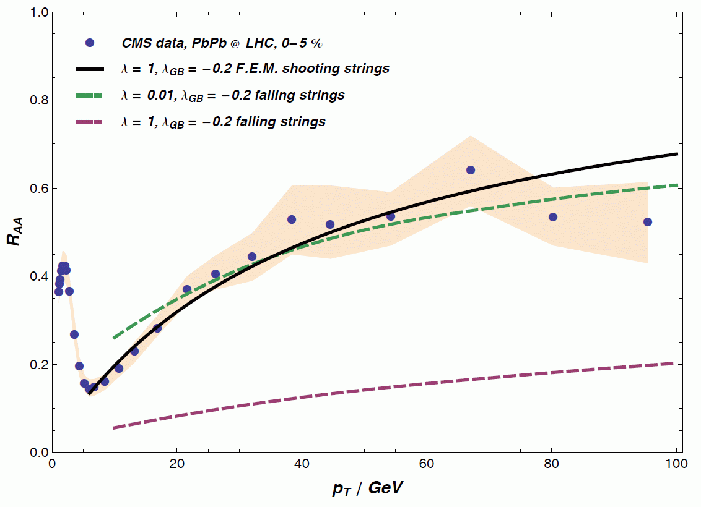
More results

Slide 53
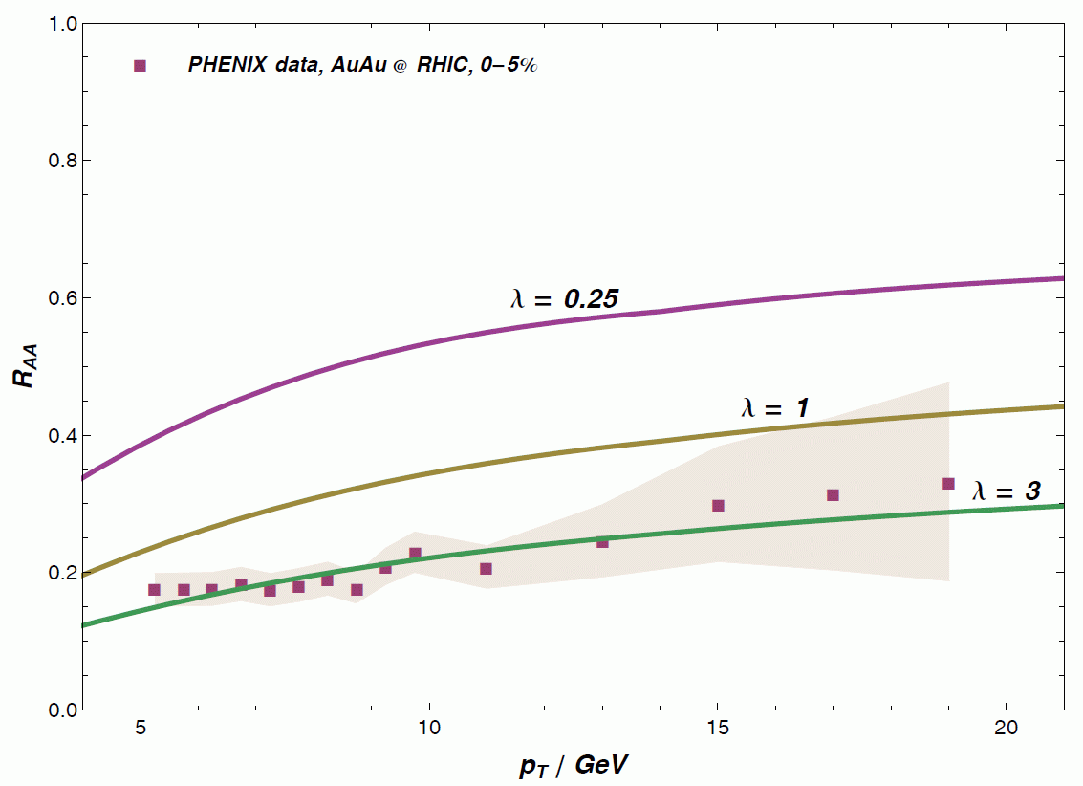
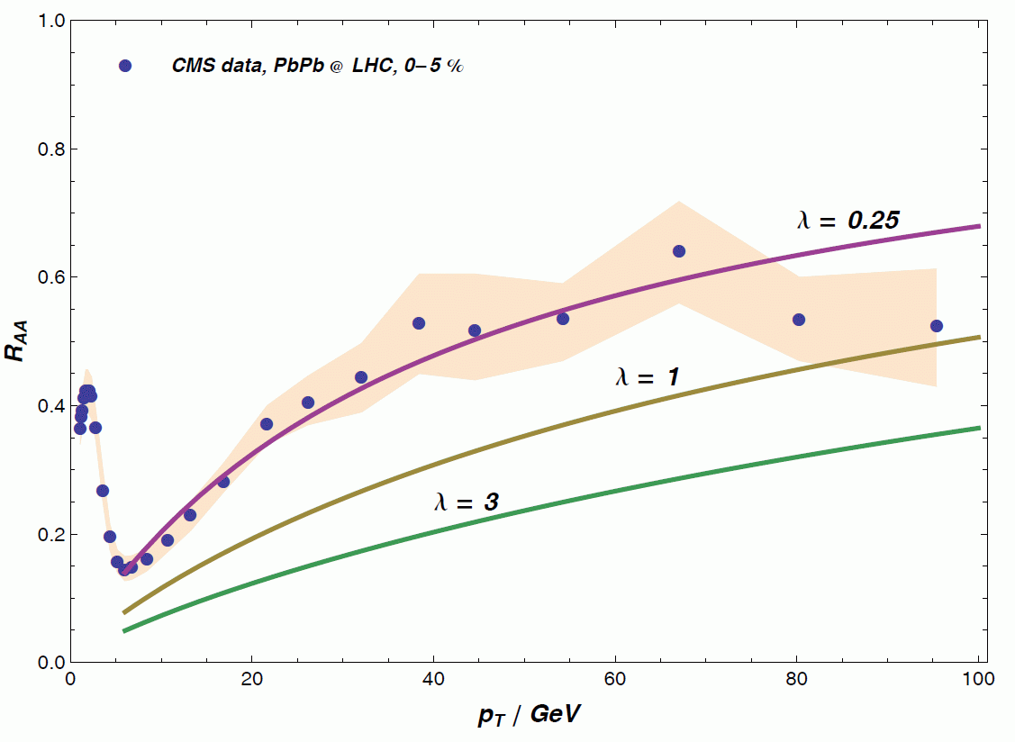
Conformal R_{AA} – central RHIC & LHC
Energy independent energy loss gives a rising
“Surprising transparency”
Horowitz & Gyulassy, 2011
(Non-conformal FT’s can (only) partially resolve this)
Shooting strings at RHIC and LHC | Andrej Ficnar
17/22

Slide 54
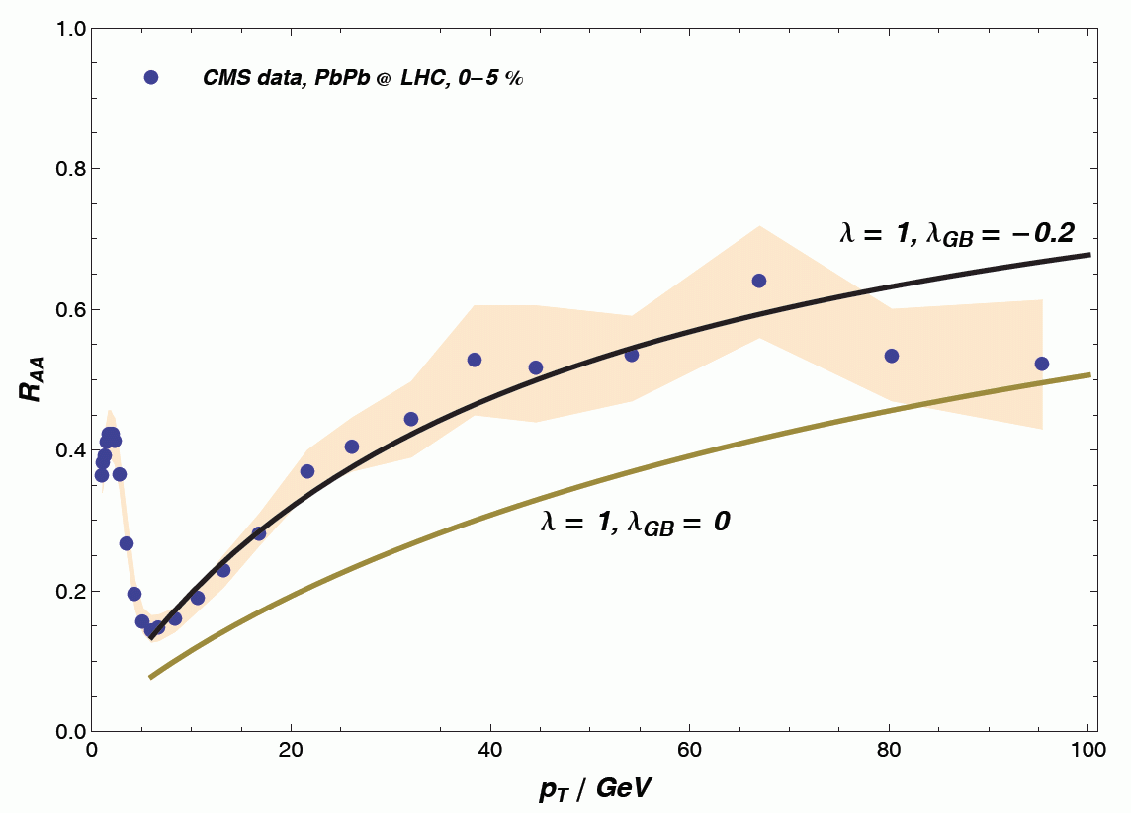
Higher derivative corrections and R_{AA}
Shooting strings at RHIC and LHC | Andrej Ficnar
19/22

Slide 55
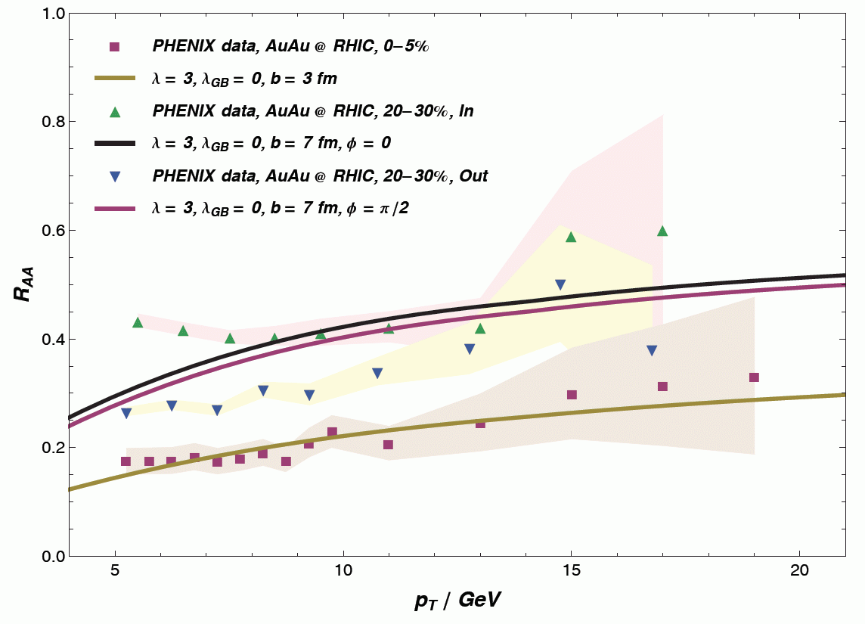
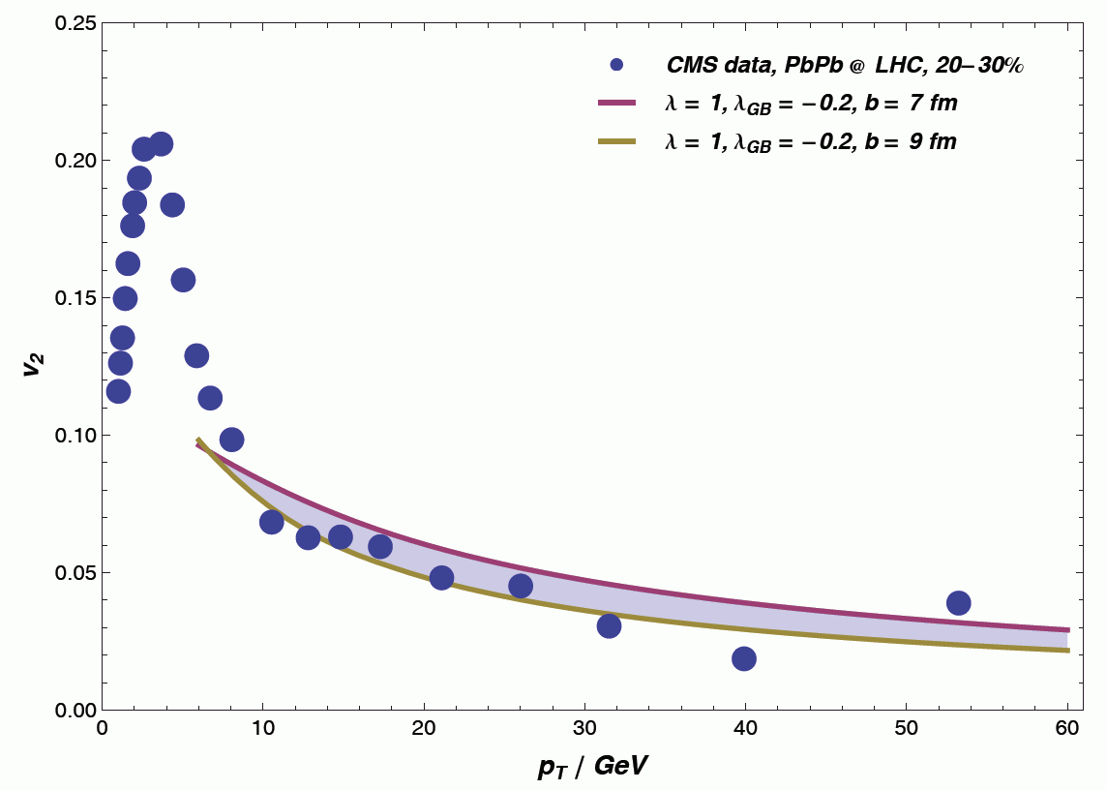
Non-central R_{AA} and v₂
Need better transverse expansion
in
out
central
Shooting strings at RHIC and LHC | Andrej Ficnar
20/22

Slide 56
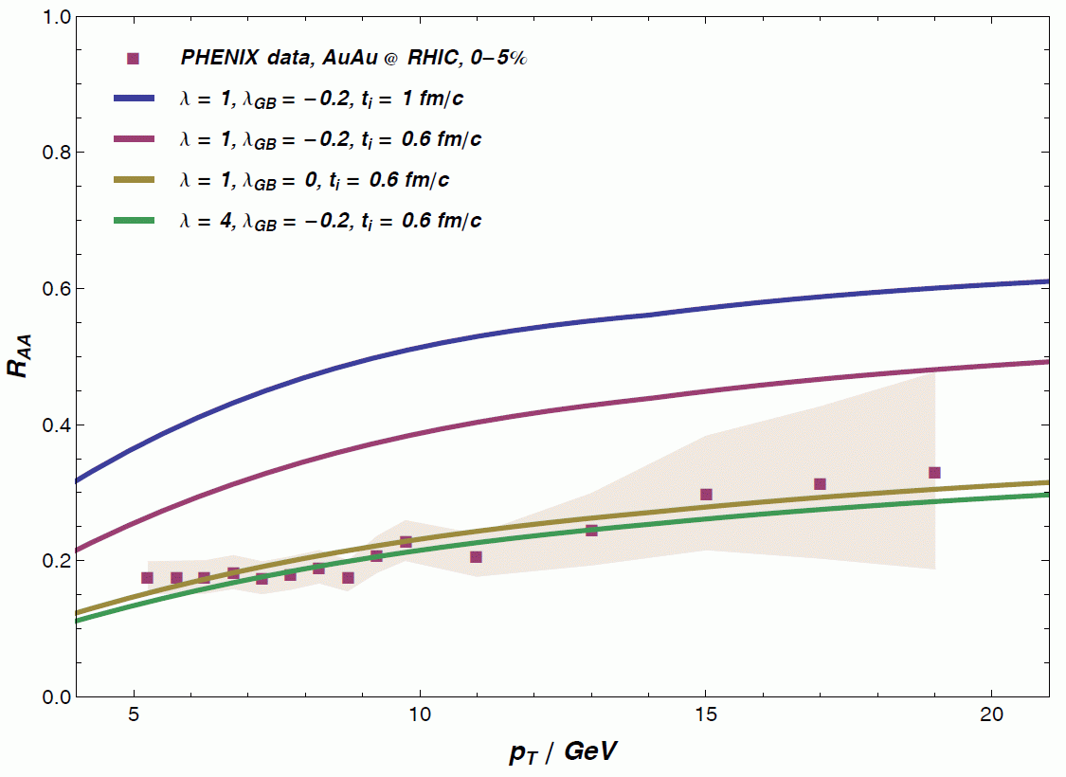
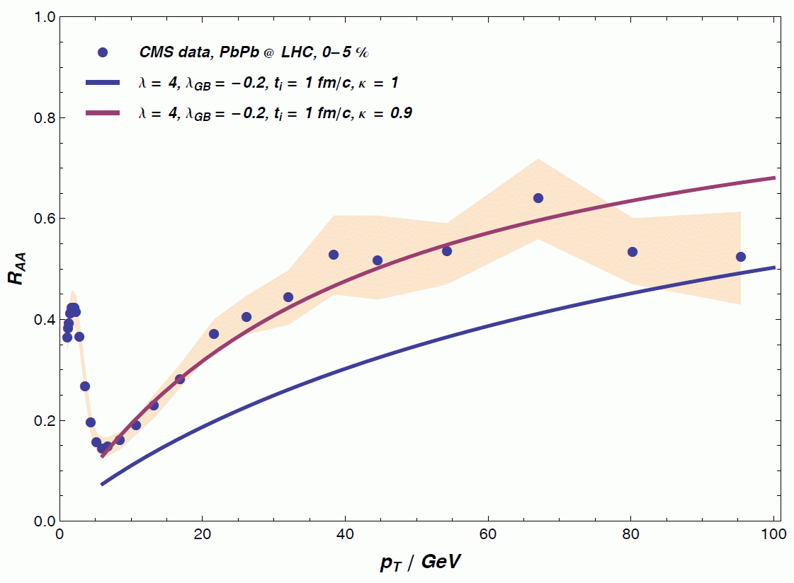
Temperature sensitivity
Energy loss very sensitive to temperature
Initial time at LHC larger than at RHIC?
Song, Bass & Heinz, 2013
Shooting strings at RHIC and LHC | Andrej Ficnar
21/22

